Slide 1
Price Management
Product Portfolio
Scorecard-Channel Portfolio
Establish the synergy between channel and portfolio alignment .
Channel & Distribution
UpskilPRO e Institute for Sales & Marketing
Tools, Content & Templates
Hand built using experience & insight

Slide 2
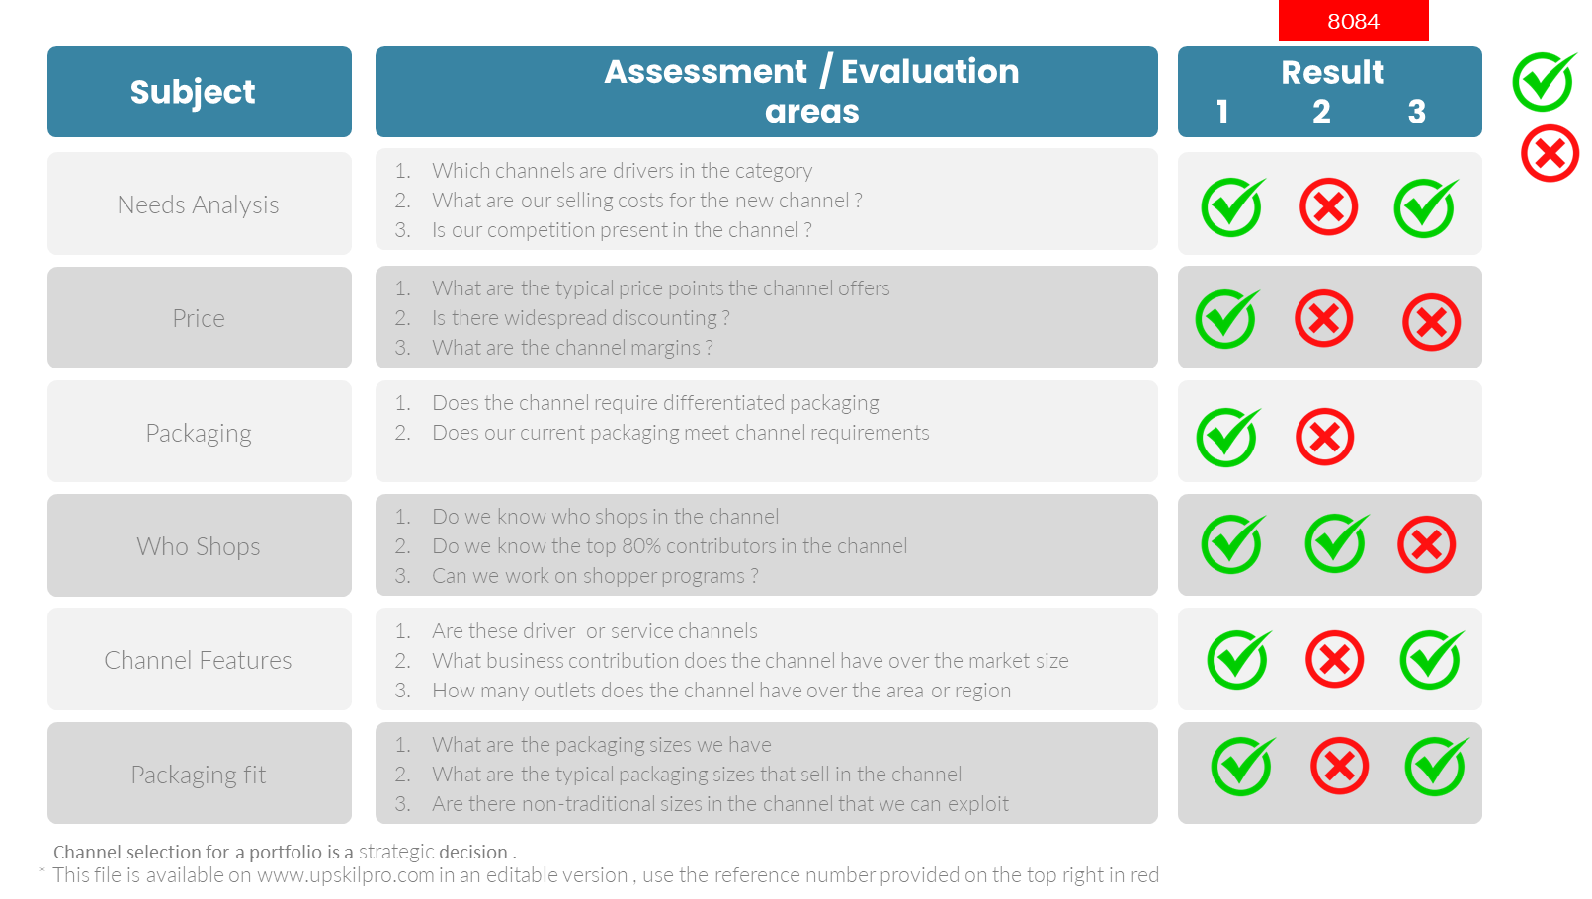
Channel Portfolio
Scorecard – Channel and Portfolio Alignment
3007

Slide 3
Price Management
Product Portfolio
Scorecard-Channel Portfolio
Establish the synergy between channel and portfolio alignment .
Channel & Distribution
UpskilPRO e Institute for Sales & Marketing
Tools, Content & Templates
Hand built using experience & insight

