Slide 1

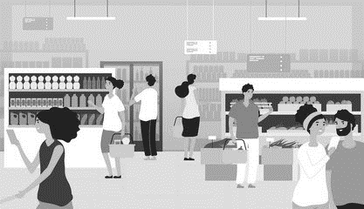
Trade Marketing & Retail
Any reseller in any channel is potentially a Trade Marketing account subject to agreed prioritization characteristics.
UpskilPRO e Institute for Sales & Marketing
Tools, Content & Templates
Hand built using experience & insight

Slide 2
Overview of the Retail Industry

Slide 3
Trade Marketing & Retail
Retail market worldwide - Statistics & Facts
Retail relates to the sale of goods and services to consumers. Transactions take place through various channels of distribution across an ever-growing range of industries, such as food, motor vehicles, apparel, and electronics. While physical or in-store retail is the dominant channel in this market, forms of non-store retailing are becoming increasingly popular too. Online retailing or e-commerce channels are carving out a share of the retail sector in many global markets. Many retailers operate an omnichannel model, which aims to integrate offline and online channels in a seamless way. In 2021, the global retail market generated sales of over 26 trillion U.S. dollars, with a forecast to reach over 30 trillion U.S. dollars by 2024.
The world’s leading retail markets
The United States is home to the top three retail companies of the world, namely Walmart, Amazon, and Costco. In 2021, the total retail market of the United States reached a revenue of over 6.5 trillion U.S. dollars. Another giant market in the consumer goods and retail industry, China's retail revenue was 13.1 trillion yuan, or some two trillion U.S. dollars in 2020. Looking at other countries with booming retail markets, India’s retail sales was estimated to reach 1.2 trillion U.S. dollars in 2021. The country’s retail industry is dominated by the unorganized or the informal sector, which is defined as businesses held by own account workers i.e., self-employed individuals or household members assisting them. In Europe, the United Kingdom and Germany are two of the leading retail markets. In 2021, retail sales in Great Britain amounted to over 465 billion British pounds, or roughly 560 billion euros, while Germany recorded retail sales worth 586 billion euros in the same year.
Global retail market trends: sustainability
In recent years, sustainability has become one of the key metrics both for retailers and consumers. Many consumers view making green and sustainable choices when shopping as beneficial not just for the environment, but also for themselves. Despite the positive trend, sustainable products are not as widely accessible and affordable as their mainstream counterparts. For consumers around the world, price remains to be the main driver for purchasing more sustainably. In a survey, over one-third of consumers said if prices were more comparable to alternatives, they would be encouraged to buy more sustainable products.
Global Retail Sales
27.34 Trillion $
Brick & Mortar Retail Sales
19.86 Trillion $
E commerce
5.76 Trillion $
Source: Statista.com

Slide 4
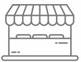

Trade Marketing & Retail.
Retail Channels.
Retail
Stores
Online
Retailing
Catalogue
Retailing
Direct
Selling
Television Home Shopping
Automated Retailing
Retailing refers to the sale of products or services through various channels which engage with the end consumer directly , they may be both traditional or digital
Department stores:
Specialty stores
Discount stores:
Convenience stores
Supermarkets
Warehouse stores:
Online retailers:
Pop-up stores:
Outlet stores:
Mom-and-pop stores
Online retailing refers to the sale of products or services through digital channels, such as websites or mobile apps.
Amazon.com:
eBay:
Etsy:.
Walmart.com:
Target.com:
BestBuy.com:
Zappos.com:
Wayfair.com.
Sephora.com
Chewy.com
Catalogue retailing, also known as mail-order retailing, involves the distribution of product catalogues to customers, who can then place orders via mail, phone, or online.
IKEA:.
L.L. Bean:
J.C. Penney
Lands' End:
Victoria's Secret.
Oriental Trading
Pottery Barn
Hammacher
Harry & David
Fingerhut
Direct selling is a business model where products or services are sold directly to consumers by independent sales representatives, rather than through traditional retail channels.
Avon
Mary Kay
Amway
Tupperware
Herbalife
Pampered Chef
Stella &
Scentsy
Arbonne
Advocare
Television home shopping involves the sale of products through dedicated TV channels that showcase products and encourage viewers to call a phone number or go online to make a purchase.
QVC
HSN
ShopHQ:
Evine
Jewellery Television (JTV
Ideal World.
Gems TV
Telebrands
HSE24
TVSN
Automated retailing, also known as vending or self-service retailing, involves the use of automated machines to sell products or services
Vending machines.
Automated retail stores:
Photo printing kiosks:
Coin-operated laundry machines
Automated car washes:
Ticket vending machines
Bike-sharing stations:
Self-checkout kiosks:
Automated food preparation and vending machines:
www.upskilpro.com

Slide 5
Trade Marketing & Retail.
Retail Channels.
Retail
Stores
Online
Retailing
Catalogue
Retailing
Direct
Selling
Television Home Shopping
Automated Retailing
Vending machines: These machines sell a variety of products, including snacks, beverages, and personal care items, and are commonly found in public places like office buildings, schools, and airports.
Self-checkout kiosks: These kiosks allow customers to scan and pay for their own purchases in stores, eliminating the need for a cashier.
Automated retail stores: These stores use technology like RFID (radio frequency identification) and computer vision to enable customers to pick up and purchase products without the need for a cashier or checkout line.
Photo printing kiosks: These machines allow customers to print photos directly from their smartphones or memory cards, and are often found in drugstores or grocery stores.
Coin-operated laundry machines: These machines allow customers to wash and dry their clothes without the need for a laundromat or attendant.
Automated car washes: These machines use sensors and sprayers to clean cars automatically, eliminating the need for a human car washer.
Ticket vending machines: These machines allow customers to purchase tickets for events like concerts and sports games without the need for a box office or ticketing agent.
Bike-sharing stations: These stations allow customers to rent bicycles for a period of time using an automated kiosk, and are often found in urban areas.
Automated food preparation and vending machines: These machines use technology like robotics and 3D printing to prepare and dispense food and beverages, eliminating the need for a human chef or barista.
Department stores: These retailers offer a wide range of products, including clothing, electronics, home goods, and more.
Specialty stores: These retailers focus on a specific type of product, such as books, shoes, or sporting goods.
Discount stores: These retailers offer products at lower prices than traditional retailers, often by buying in bulk or using cost-cutting measures.
Convenience stores: These retailers offer a limited selection of products, often focused on snacks, beverages, and other items that are frequently purchased on the go.
Supermarkets: These retailers offer a wide range of food and household items, often organized into different departments such as produce, meat, and bakery.
Warehouse stores: These retailers offer products in bulk quantities, often at lower prices than traditional retailers.
Online retailers: These retailers sell products online, often without physical storefronts.
Pop-up stores: These temporary retail locations can be found in a variety of locations, including malls, parking lots, and other high-traffic areas.
Outlet stores: These retailers sell discounted products that are often overstocked or discontinued items from traditional retailers.
Mom-and-pop stores: These small, independently owned retailers offer a personalized shopping experience and often specialize in niche products.
Amazon.com: One of the world's largest online retailers, offering a wide range of products including books, electronics, clothing, and more.
eBay: An online marketplace where individuals and businesses can buy and sell a variety of goods.
Etsy: An online marketplace focused on handmade or vintage goods, as well as unique factory-manufactured items.
Walmart.com: The online arm of the retail giant Walmart, offering a range of products including groceries, clothing, electronics, and more.
Target.com: The online arm of the retail chain Target, offering a variety of products including clothing, home goods, and electronics.
BestBuy.com: An online retailer specializing in electronics, including computers, televisions, and audio equipment.
Zappos.com: An online shoe retailer, known for its wide selection of shoes and excellent customer service.
Wayfair.com: An online home goods retailer, offering a wide range of furniture, décor, and other household items.
Sephora.com: An online retailer specializing in beauty and cosmetic products.
Chewy.com: An online retailer specializing in pet food, supplies, and medications.
IKEA: A furniture and home goods retailer that offers both physical catalogues and online versions for customers to browse and order from.
L.L. Bean: A clothing and outdoor equipment retailer that started as a mail-order company and still offers a print catalogue to customers.
J.C. Penney: A department store that offers an extensive catalogue of clothing, home goods, and other items that customers can order via phone or online.
Lands' End: A clothing and home goods retailer that started as a sailboat hardware supply company and now offers catalogues and online ordering.
Victoria's Secret: A lingerie and women's clothing retailer that offers a print catalogue and online ordering.
Oriental Trading: A party supplies and decorations retailer that offers a print catalogue for customers to browse and order from.
Pottery Barn: A home furnishings and decor retailer that offers both print and online catalogues.
Hammacher Schlemmer: A gadget and gift retailer that offers a print catalogue and online ordering.
Harry & David: A gourmet food and gift retailer that offers a print catalogue and online ordering.
Fingerhut: A retailer offering a wide range of products including clothing, electronics, and home goods that customers can order via print catalogue or online.
Avon: A beauty and personal care company that sells its products through a network of independent sales representatives.
Mary Kay: A cosmetics company that uses independent sales consultants to sell its products.
Amway: A multi-level marketing company that sells health, beauty, and home care products through a network of independent sales representatives.
Tupperware: A home goods company that sells its products through parties and demonstrations hosted by independent consultants.
Herbalife: A nutritional supplement company that uses independent distributors to sell its products.
Pampered Chef: A kitchen tools and cookware company that uses a direct selling model to sell its products.
Stella & Dot: A jewellery and accessories company that uses independent stylists to sell its products.
Scentsy: A company that sells scented products and home decor items through independent consultants who host parties and sell to their networks.
Arbonne: A company that sells skincare, makeup, and nutrition products through a network of independent consultants.
Advocare: A company that sells nutritional supplements, weight loss products, and sports performance products through independent distributors.
QVC: A TV home shopping network that offers a wide range of products, including home goods, clothing, beauty products, and more.
HSN (Home Shopping Network): Another TV home shopping network that offers a variety of products, including electronics, jewellery, and clothing.
ShopHQ: A TV shopping network that specializes in home goods and appliances.
Evine: A TV shopping network that offers a range of products, including fashion, jewellery, beauty products, and home goods.
Jewellery Television (JTV): A TV shopping network that focuses on jewellery and gemstones.
Ideal World: A TV shopping network based in the UK that offers a range of products, including electronics, fashion, and home goods.
Gems TV: A UK-based TV shopping network that specializes in jewellery and gemstones.
Telebrands: A TV shopping network that focuses on "As Seen On TV" products, including gadgets, kitchenware, and beauty products.
HSE24: A TV shopping network based in Germany that offers a variety of products, including fashion, home goods, and electronics.
TVSN: A TV shopping network based in Australia that offers a range of products, including fashion, beauty products, and home goods.
www.upskilpro.com

Slide 6
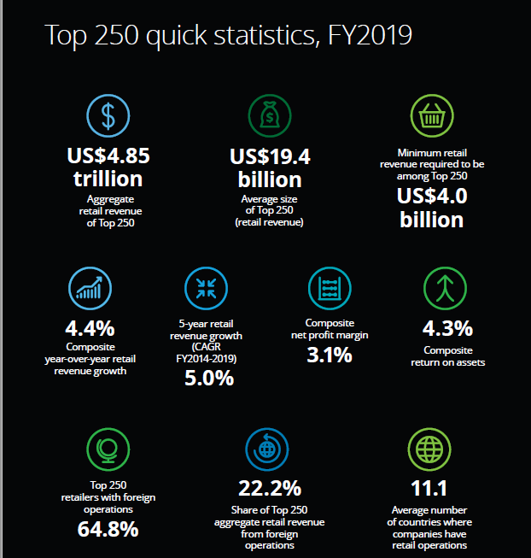
Trade Marketing & Retail.
Top 250 Retailers : Retail Channels.
Source: Deloitte Touche Tohmatsu Limited. Global Powers of Retailing 2021
www.upskilpro.com

Slide 7
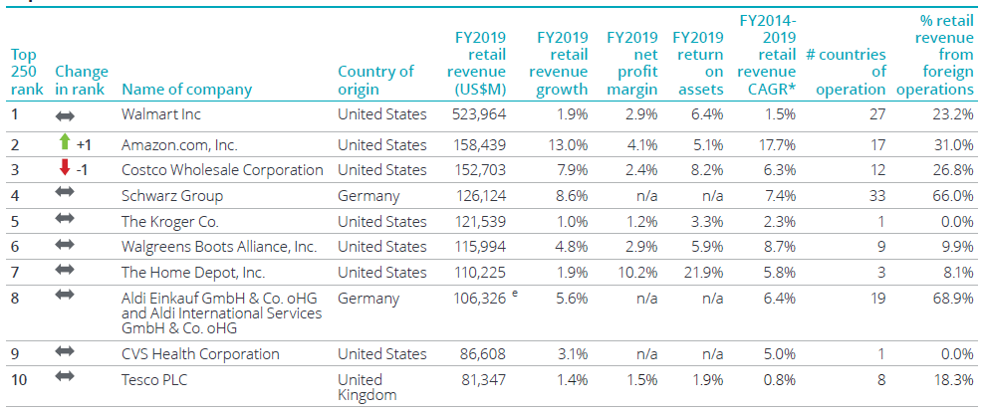
Trade Marketing & Retail
Retail market worldwide - Statistics & Facts
Source: Deloitte Touche Tohmatsu Limited. Global Powers of Retailing 2021

Slide 8
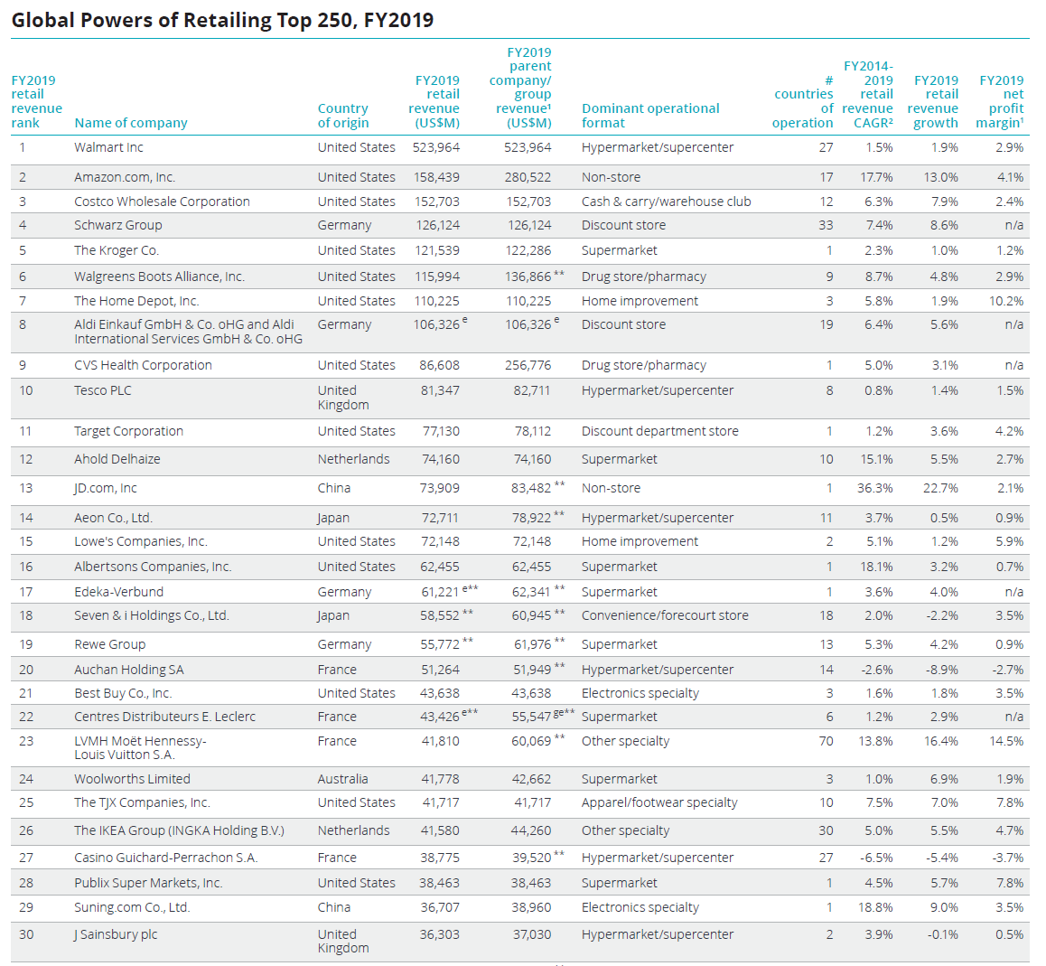
Trade Marketing & Retail
Retail market worldwide - Statistics & Facts
Source: Deloitte Touche Tohmatsu Limited. Global Powers of Retailing 2021

Slide 9
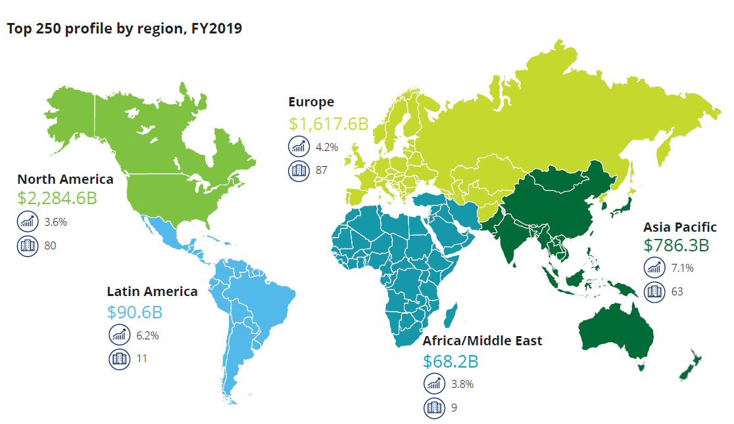
Trade Marketing & Retail
Geographic Analysis
For the purposes of geographic analysis, companies are assigned to a region based on the location of their headquarters, which may not always coincide with where they derive the majority of their sales.
Although many companies service sales from outside their region, 100% of each company’s sales are accounted for within the region that the company is headquartered in.
FY2019 retail revenue in US$
YoY Change in %
No. of companies
Results reflect Top 250 retailers headquartered in each region/country
Source: Deloitte Touche Tohmatsu Limited. Global Powers of Retailing 2021. Analysis of financial performance and operations for fiscal years ended through 30 June 2020 using company annual reports, Supermarket News, Forbes America’s largest private companies and other sources.
Source: Deloitte Touche Tohmatsu Limited. Global Powers of Retailing 2021

Slide 10
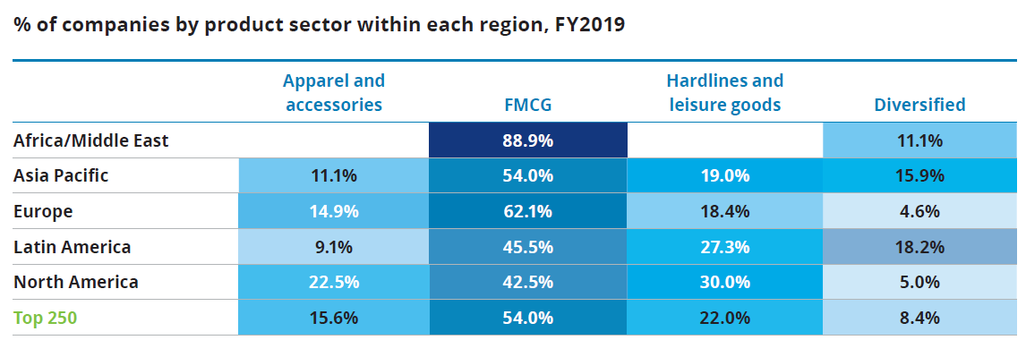
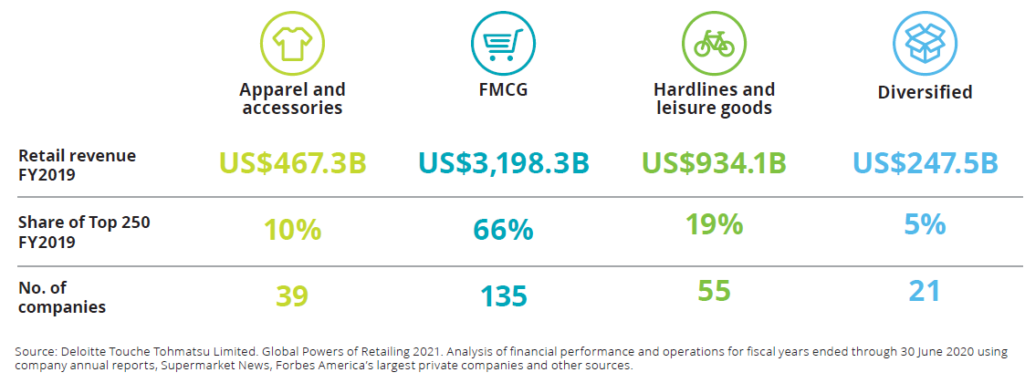
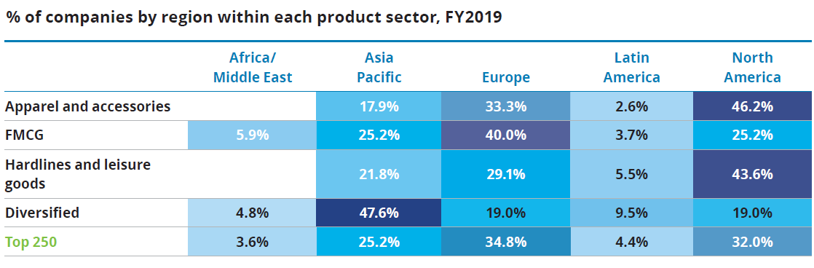
Trade Marketing & Retail
% of companies by product sector within each region, FY2019
Source: Deloitte Touche Tohmatsu Limited. Global Powers of Retailing 2021

Slide 11
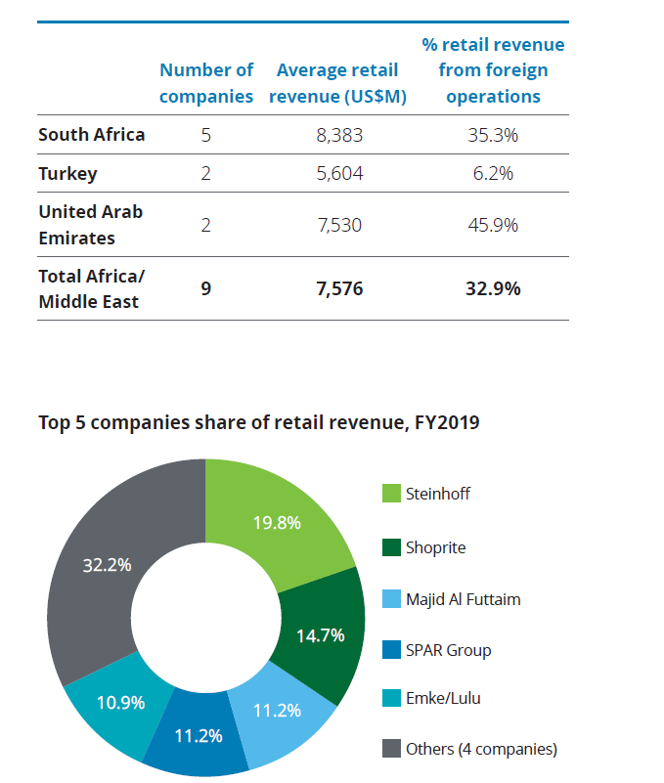
Trade Marketing & Retail
Africa / Middle East – Retail Snapshot 2019
Africa/Middle East
The nine retailers in the Top 250 from the Africa/Middle East region are based in South Africa, Turkey, and the United Arab Emirates. They are more international than any other region, with all retailers except Turkey’s A101 operating outside their home country. The region recorded the highest fiveyearFY2014-2019 CAGR (9.3%), nearly double the Top 250composite growth. YoY growth was lower than the Top 250growth rate, at 3.8%. Turkish discounters A101 Yeni Mağazacılık,and BİM Birleşik Mağazalar continued their rapid store expansion, each adding around 900 stores to their network across their home country.
The leading retailer in the region, South Africa’s Steinhoff, saw retail revenue fall again, by 5.8%, as the company’s new management board continued its financial restructuring measures, selling the Blue Group holding company, the owner of furniture retail chains in the United Kingdom, in November2019,54 and the ABRA furniture business in September 2019.55Pepkor Africa and Pepco Group (formerly Pepkor Europe)
performed well. Steinhoff postponed their planned 2020 IPO of Pepco Group, following the slump in stock market prices resulting from the COVID-19 pandemic.56The Africa/Middle East region had the lowest composite net profit margin, -3.3%, mainly due to Steinhoff’s losses.
Source: Deloitte Touche Tohmatsu Limited. Global Powers of Retailing 2021

Slide 12
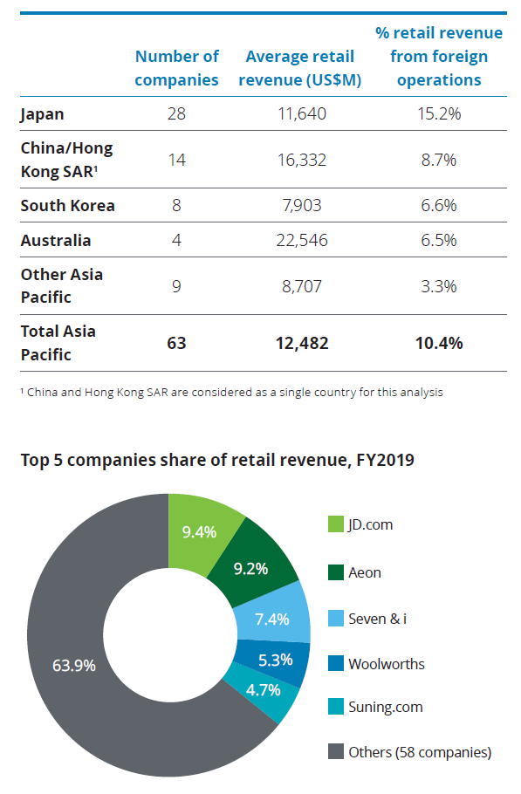
Trade Marketing & Retail
Asia Pacific – Retail Snapshot 2019
Asia Pacific
Retailers based in the Asia Pacific region increased their share of the global Top 250 revenue by 0.8 percentage points, to 16.2%, with more new entrants than any other region. They also achieved the highest FY2019 YoY growth, at 7.1%. Seventeen companies had double-digit growth in retail revenue in FY2019, led by Alibaba and South Korea’s Coupang. Regional leader JD.com added over US$13 billion in
retail revenue, mainly driven by an 18.6% increase in active customers on their online retail site, to 362 million in 2019.
As a group, the 14 Chinese retailers had a higher YoY growth (11.7%) than retailers in any other major Top 250 country. The 2.7% net profit margin for companies in the region was slightly lower than the Top 250 composite. SM Investments from the Philippines, and Japan’s Nitori Holdings were the only
companies reporting double-digit net profit margins. Retail leaders in the Asia Pacific region are dominated by companies from Japan and China/Hong Kong SAR, with other companies based in India, South Korea, Australia, Thailand, Indonesia, the Philippines, Taiwan and Vietnam. Just over half
have retail operations in more than one country, but these are often relatively small in scale. Only seven companies reported more than 20% of their retail revenue from foreign operations
Source: Deloitte Touche Tohmatsu Limited. Global Powers of Retailing 2021

Slide 13
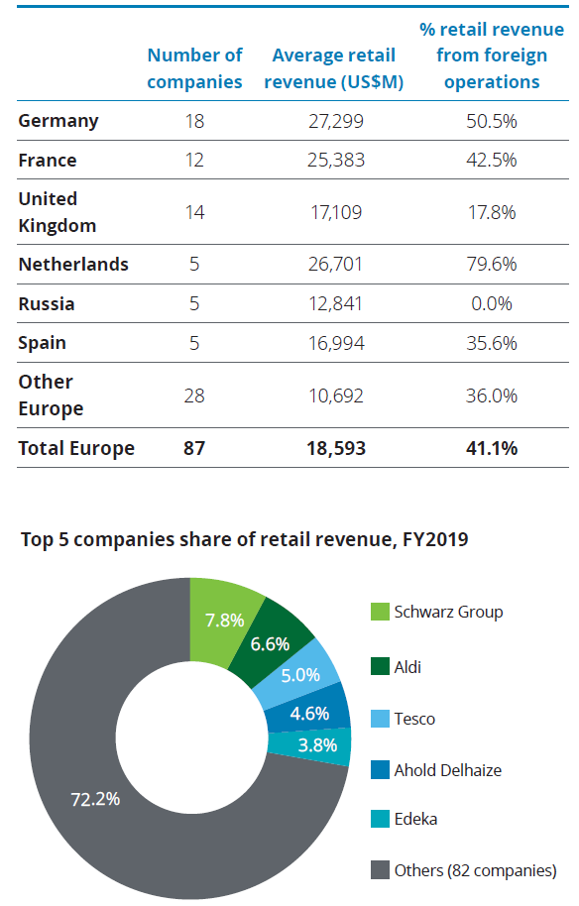
Trade Marketing & Retail
Europe – Retail Snapshot 2019
Europe
Europe again had the largest number of retailers in the Top 250 in FY2019 (87 companies), seven more than North America, contributing 33.4% of the Top 250 retail revenue.
European companies had the highest level of internationalization, in their search for growth outside their mature home markets. Only 13 European retailers had no
foreign retail operations, five of which were based in Russia, and three were based in the United Kingdom. Retail revenue YoY growth improved to 4.2%, just below the
Top 250 composite growth rate. Sixteen companies reported double-digit growth, primarily luxury retailers, sports retailers, and discount retailers. Sixteen retailers reported declining sales, most of which were grocery retailers.
The composite net profit margin for the 65 European retailers reporting net profits was 2.9%, 0.2 percentage points below the Top 250 composite. Five retailers reported double-digit net profit margins: luxury retailers LVMH, Kering and Hermès, and
fashion retailers Inditex and Next. Eight retailers reported a loss, nearly all of them are grocery retailers. Troubled discount store Dia was the only retailer reporting a double-digit net margin loss, as it went through a major restructuring and
refinancing in 2019. The 28 ‘other Europe’ companies are based in Austria, Belgium,
Denmark, Finland, Italy, Lithuania, Norway, Portugal, Sweden, and Switzerland.
Source: Deloitte Touche Tohmatsu Limited. Global Powers of Retailing 2021

Slide 14
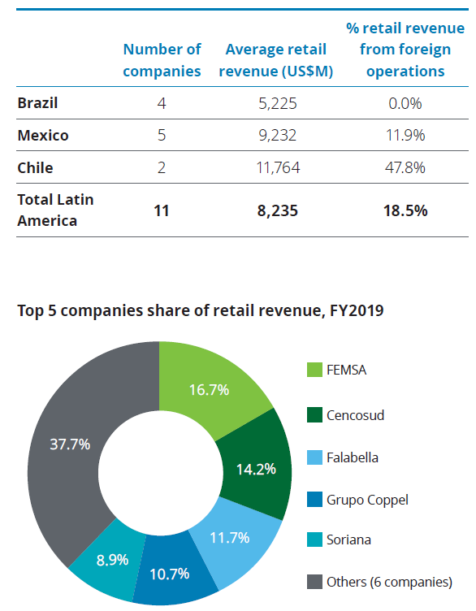
Trade Marketing & Retail
Africa / Middle East – Retail Snapshot 2019
Latin America
The 11 retailers from Latin America recorded the second highest retail revenue growth (both five-year CAGR and YoY) and net profit margin in FY2019, compared to other regions.
The four smallest retailers from the region are based in the largest country, Brazil. Two of these, Magazine Luiza and Raia Drogasil, reported the highest YoY growth, of 27.5% and
18.5%, respectively, driven mainly by rapid store expansion, plus e-commerce growth for Magazine Luiza, and the acquisition of 42 Onofre stores from CVS for RaiaDrogasil.57 All
of the Mexican retailers, except Soriana, also delivered above average growth.
The two Chilean retailers, Cencosud and Falabella, are the most international, both operating across Latin America, in Argentina, Brazil, Chile, Colombia,and Peru, with Falabella also operating in Mexico and Uruguay. All retailers except Brazil’s Via Varejo were profitable, with Mexican department store El Puerto de Liverpool reporting the highest net profit margin at 8.6%
Source: Deloitte Touche Tohmatsu Limited. Global Powers of Retailing 2021

Slide 15
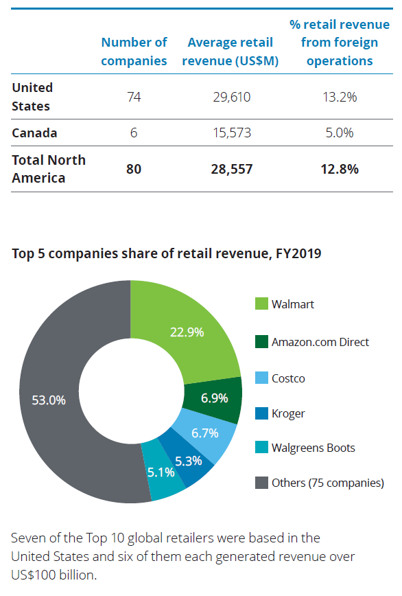
Trade Marketing & Retail
Africa / Middle East – Retail Snapshot 2019
North America
North American retailers contributed nearly half of the total Top 250 revenue in FY2019, and had the largest average retail revenue, US$28.6 billion. Their revenue from foreign countries remained low, with nearly half of all companies only having retail operations in their home market.
Retailers from this region recorded the lowest composite FY2014-2019 CAGR and YoY FY2019 growth. Seven companies achieved double-digit growth; three were primarily due to prior M&A activity. Canada’s Metro Inc continued to gain YoY sales from its May 2018 acquisition of the Jean Coutu Group. PetSmart’s growth was mainly from online pet retailer Chewy Inc. (acquired in 2017), still majority owned by PetSmart following its 2019 IPO. Marathon Petroleum’s convenience stores saw retail merchandise growth from the October2018 acquisition of 574 convenience stores from Andeavor. E-commerce giants Amazon.com and Wayfair continued their strong growth trajectory.
However, 23 retailers lost sales inFY2019, with GameStop, Ascena Retail Group and Tapestry all reporting double-digit declines. GameStop and Ascena both saw dropping comparable store sales, and store closures. Tapestry lost sales primarily due to the impact of COVID-19 in their fourth quarter, April to June 2020. The 54 North American retailers reporting net profits delivered the highest composite net profit margin, 3.6%, 0.5 percentage points above the Top 250 composite net profit margin. Five specialist and discount companies achieved double-digit net profit margins: home improvement leader Home Depot, discount apparel and home fashion retailer Ross Stores, auto parts retailers AutoZone and O’Reilly Automotive, and luxury jeweller Tiffany (which was acquired by luxury giant LVMH in January 2021).58 Only nine retailers reported a loss.
Source: Deloitte Touche Tohmatsu Limited. Global Powers of Retailing 2021

Slide 16
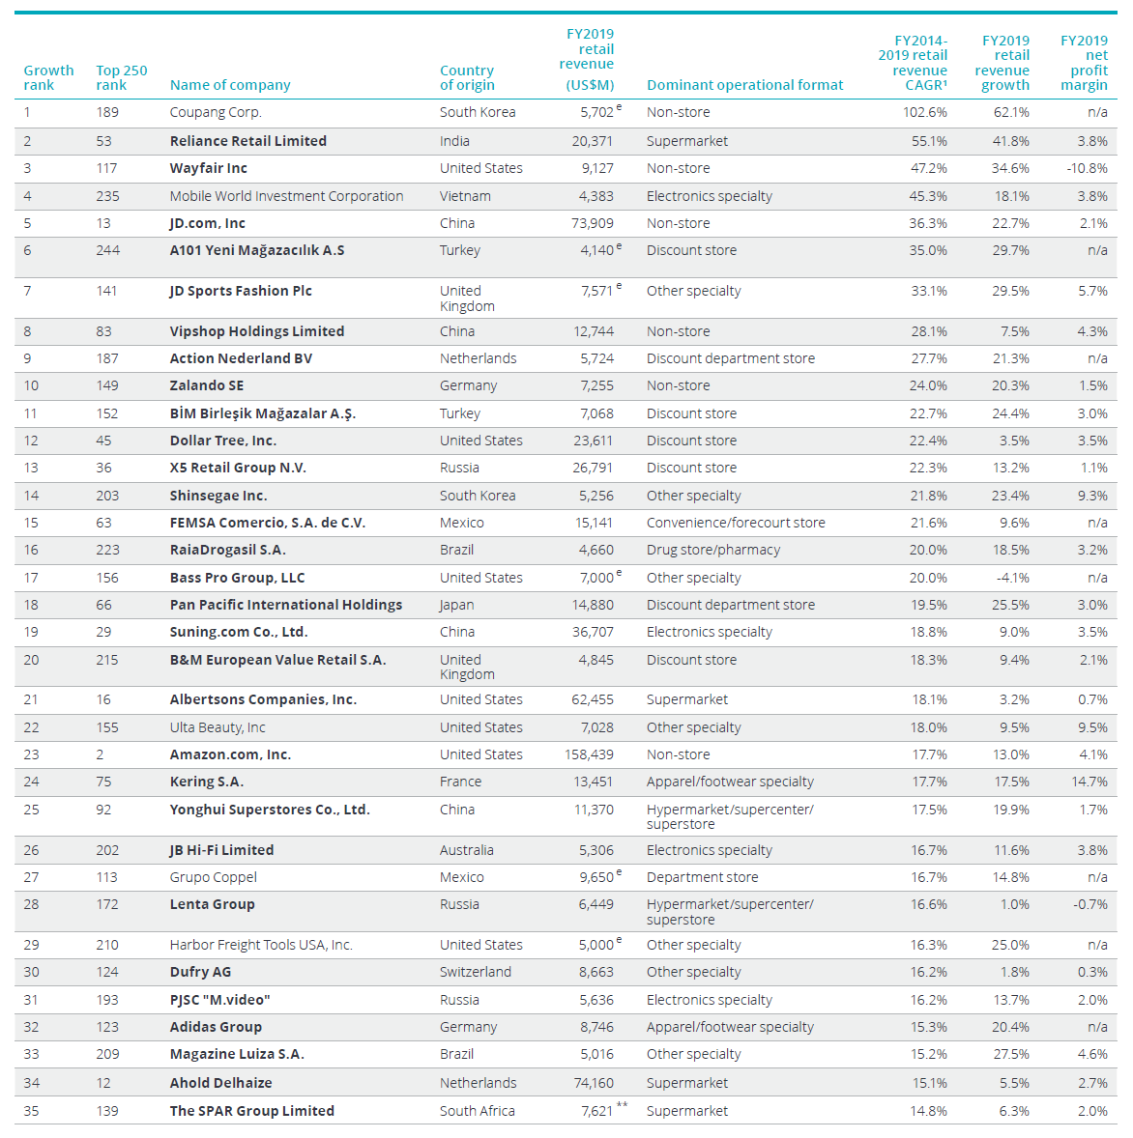
Trade Marketing & Retail
Fastest 50 retailers, FY2014-2019
Types of Stores
Supermarkets
Electronics stores
Discount stores
Department stores
Convenience stores
Forecourts
Apparel stores
Footwear stores
Hypermarkets
Speciality stores
Drug Stores
From the report we notice there are at least 10 different types of retail which indicates that the trade marketing services can be creatively used in more than just FMCG related retail environments.
Fastest 50 and Top 250 composite net profit margins exclude results for companies that are not primarily retailers.
¹ Compound annual growth rate
** Revenue includes wholesale and retail sales
e = estimate
n/a = not available
Source: Deloitte Touche Tohmatsu Limited. Global Powers of Retailing 2021

Slide 17
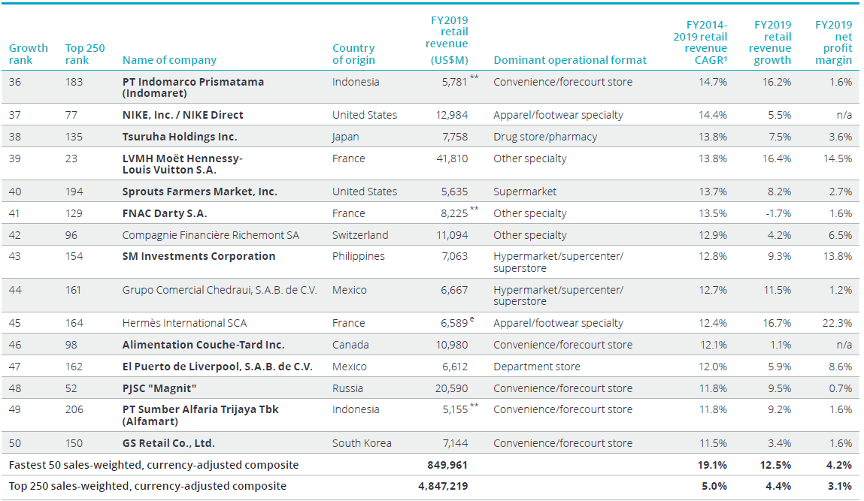
Trade Marketing & Retail
Fastest 50 retailers, FY2014-2019
Types of Stores
Supermarkets
Electronics stores
Discount stores
Department stores
Convenience stores
Forecourts
Apparel stores
Footwear stores
Hypermarkets
Speciality stores
Drug Stores
From the report we notice there are at least 10 different types of retail which indicates that the trade marketing services can be creatively used in more than just FMCG related retail environments.
Fastest 50 and Top 250 composite net profit margins exclude results for companies that are not primarily retailers.
¹ Compound annual growth rate
** Revenue includes wholesale and retail sales
e = estimate
n/a = not available
Source: Deloitte Touche Tohmatsu Limited. Global Powers of Retailing 2021

Slide 18
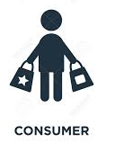
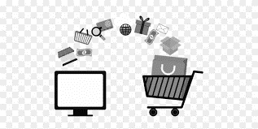
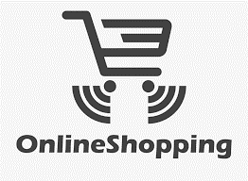



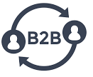
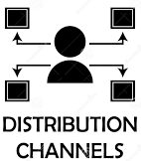













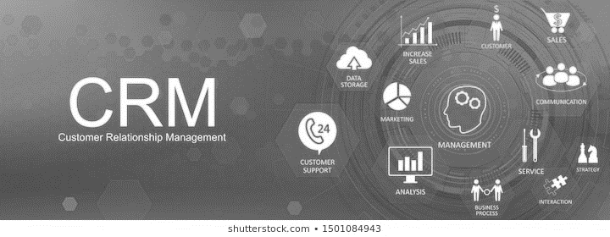





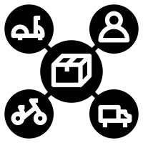
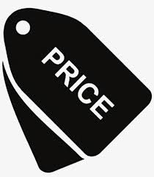


Trade Marketing & Retail
Traditional & e marketing mix
We drafted a high-level view of the marketing landscape .
It is for the audience to view the whole perspective of Marketing specialties and the various segmentations within them.
Online Shopping
Social Media
Offline Shopping
e-Communication
Search Engine
Customer Relationship Management
Traditional Media
Events
Traditional Communication
Research
Marketing Mix
Analytics

Slide 19
Trade Marketing & Retail
10 Digital Marketing Trends In 2022
Inform, entertain or inspire.
These are the top 10 trends we believe are and will influence Digital marketing this year , however for your industry there might be specificities which need to be taken in to account.
We recommend adapting this slide to your requirement.
Facebook has peaked .
Instagram is a hit with the Kids
Social Media
Why not?
Video matters and is no longer an option
Good Content Matters
Email is Getting More Personalized
Omnichannel Marketing is Now vital.
Content
AI Content will become mainstream
Voice Interaction Continues Upward
Marketing in Messaging Apps Will Level-Up
Chatbots Will dominate customer service
Engagement

Slide 20
Trade Marketing & Retail
Marketing spend by Industry 2019
Comment 01
All figures in % of spend on revenue .
Comment 02
Highest percentage spend ins the Retail industry .
Comment 04
Companies that sell more than 10 % of sales online continue to invest in the region of 13% on marketing .
As opposed to companies in a traditional sales model without sales online invest up to 10.5% on marketing
Comment 03
Source of information is the CMO spend survey

Slide 21
Trade Marketing & Retail
Marketing spend by Industry 2022
Where is the Money Going?
When CMOs in the Gartner survey were asked to report their budget allocations across the marketing department’s program and operational areas, brand strategy and activation accounted for nearly 10 percent of the overall marketing budget.
CMOs also identified strategic capability gaps that need to be addressed. Twenty-six percent of CMOs report marketing data and analytics as a top capability gap, while 23 percent said customer experience management. Twenty-two percent said marketing technology needs better funding.
According to author Bernard Marr, in terms of marketing technology, expect investments to focus on the deployment of AI capabilities in a variety of software applications. One of the more notable uses of this technology is for natural language processing (NLP) to create more useful and relevant chatbots that will expand their use beyond simple question and answer scenarios.
Virtual, augmented, and mixed reality (VR/AR/MR) are being adopted into various marketing strategies and business initiatives. AR is being used for virtual products and clothes, while VR is finally becoming more viable for gaming.
In 2021, 35 percent of marketers were leveraging AR or VR in their strategies. Of those marketers, 42 percent plan to increase their investment in 2022.
According to the Gartner survey, average marketing spend has increased across almost all of the industries surveyed. Financial services companies recorded the highest budget, at 10.4 percent of total company revenue, up from 7.4 percent in 2021. While almost all industries saw budget increase, CMOs in consumer goods report their spending has stagnated.
Source : cdp.com/articles/marketing-budgets-2022
Gartner marketing

Slide 22

Trade Marketing & Retail.
Basic Channel Approach
Overall Category Sales Contribution
Your category sales contribution . Both are different , this requires category insight to find out if your brand is under contributing .
Basic go to market layout of channels
Push Campaigns
Sales
Contribution
Category
Contribution
Direct Sales
Channel partners
Brand Owner
or
Manufacturer
Value Added Resellers
Internet / reseller
Wholesalers / Stockists
Pull Campaigns
Comment
Focus on category contribution accounts , as these will drive the consumer engagement
Most generic descriptors have been used for channels
The model uses a flow from manufacturing to customer / end-user .
The emerging channel is the online reseller who is able to resell online to other e commerce resellers
Demand creation campaigns using the marketing mix
www.upskilpro.com

Slide 23
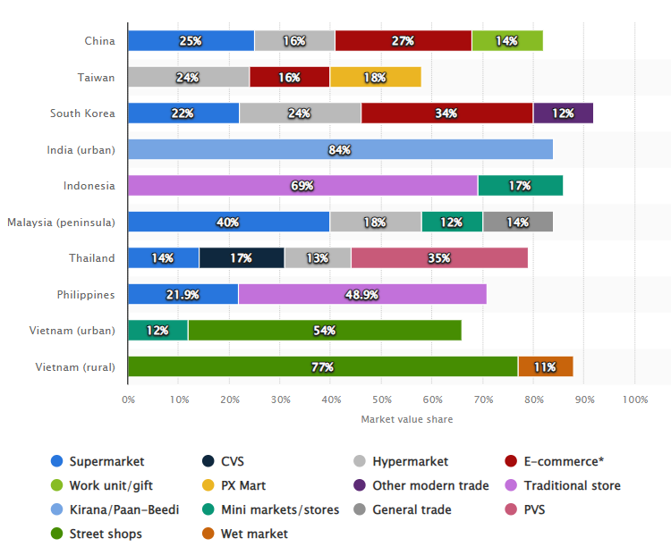
Trade Marketing & Retail.
Retail Channels Asia.
Every country has a specific set of channels that have evolved over time.
Trade marketing teams need to take in to account that different channels will take slightly different plans, promotions and mechanics to get the job done.
The complexity of multi channel trade marketing must take into account the habits of both the consumer and the customer for the plans to succeed and drive the objectives
Source: Statista.com
www.upskilpro.com

Slide 24
Trade Marketing & Retail.
Key Tools for TM execution.
Customer
Channel
Consumer
Category
Channel Analytics
Retail Audits
Channel Specific portfolios
Product demonstrations
Social media
Channel Specific promotions
Consumer research
Consumer habits
Memberships
Loyalty programs
Social Media engagement
Trade Shows
Product Demos
Contests
Door drops
Sampling
Content Marketing
Category branding
Category merchandising plan
Category communication
Category location plan
Category research
CRM engagement
Customer relationship
Customer engagement
Contribution
Contract
Digital engagement
Promotion
Pricing
Communication
Product
Sampling
Point of sale material
Incentives
Coupons
Contests
Loyalty Programs
Right price for the channel
Profitability analysis
Price communication
Price tracking
Price promotion
Leaflets
Carton communication
On pack leaflets
Category communication
Check out communication
Header boards
In pack leaflets
Right product , right channel
Benefits visibility
Product visibility
Merchandising principles
Important tools
Premiums
On pack
Off pack
redemption
Value % off
$ off
Multi packs
Right location
www.upskilpro.com

Slide 25
Types of Retailers

Slide 26
Understanding Retailer Needs

Slide 27

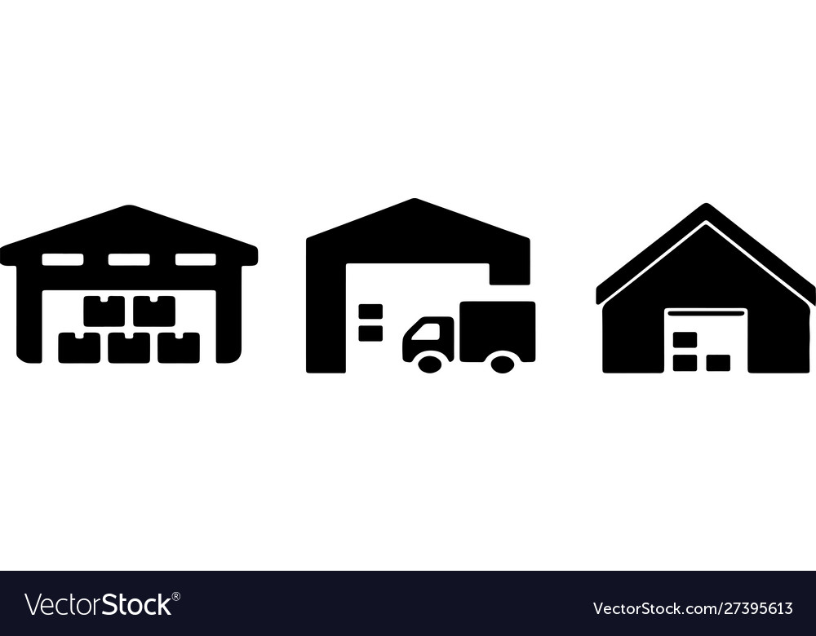
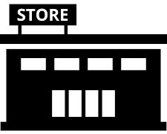

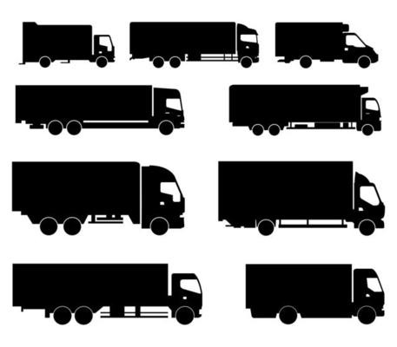

Trade Marketing & Retail.
Stages of Influence in promotion design
KPI’s
RETAILER
Manufacturing
Inland Transportation
Distribution center
Transportation
Retail
Customer
Packaging design
Product configuration
Sourcing
Material changes
Transportation flexibility
Customization
  Shrink wrapping
  Packaging configuration
  Palletization plan
  Add on material
Bill To – Ship To ease
Smaller or larger loads
Specific branding
Category customization
Communication material
Consumer research
Consumer engagement
Communication edit.
Comments
Plan the trade marketing engagement in advance so you have enough time to make changes both internally and externally
Always plan of time anticipating issues and changes
As far as possible use the system resources to construct your promotion , use fewer changes and disruptions to the process.
Get the draft plan out ahead of time to get engagement from stakeholders.
Set up a handful of critical KPI’s to get your business reviews aligned.
www.upskilpro.com

Slide 28
Trade Marketing & Retail.
Selecting Key Accounts
Country Operations
Distribution Segments
Channel Segments
Selecting your accounts for executing trade marketing calls for some data and account segmentation along with your sales priorities , channel prioritization and account demographic's / consumer research.
Electrical
Wholesale & Retailers
Local Distributors
DIY Retailers
Channel Segments | Will give the contribution breakdown of the category and the sales , which will lead to the selection and prioritization of relevant channels
Account Segmentation | This data and analysis will give you which accounts you should concentrate on to execute TM in terms of prioritization.
Sales Priorities | This will give you the customer and channel priorities which in turn will allow you to focus on the 80:20 principle
Account Demographics | This will give you the capability to mirror your brand consumer research and mirror it onto the accounts allowing you to target the right accounts
National Level Sales
State Distributors
C Store Retailers
National Distributor
Grocery Retailers
Key Accounts

Slide 29
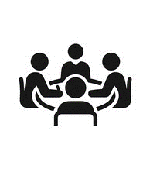

Trade Marketing & Retail.
Selection Parameters for Trade Marketing Accounts
Not all accounts can or should be key accounts.
However, every account to be in the TM list must be justified in terms of relation to the brand priorities
Channel prioritization
Data Sharing
One of the important facets of getting trade marketingg right is to concentrate on the influencer , in this case its the consumer , and then align on where the consumers are gathered in economic numbers to engage them.
Trade marketing can be planned and executed in any channel and account as long as you have your set of qualification criteria.
Every brand will have different channels and consumers , where they shop and what the buy , its important to keep the consumer focus directed at that precisely.
Most importantly TM activities can be conducted in any channel , Auto garages , Duty free , Night clubs , Supermarkets , Groceries , etc.
On the right you will see the basic selection levers for selecting a customer of choice to execute your trade marketing engagement.
Selection
Parameters
Right Demographics
Consumer access
Category engagement
Account engagement

Slide 30




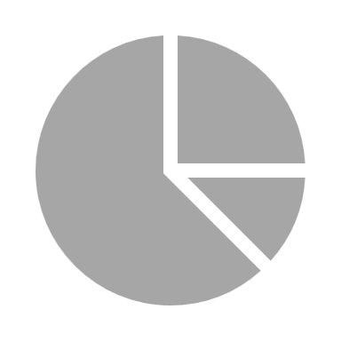






Trade Marketing & Retail.
Selecting and categorizing key customers for Trade Marketing
Stage # 1
Centralise all your account data onto one location
Align all your customer data into a spreadsheet to make analysis easier
Use 3 years historical data to smoothen the trajectory
Stage # 1
Develop the KAM or TM qualification criteria.
Align the data and the customers
Select the customers that are aligned to your criteria
Now add on qualitative aspects to further narrow down your data list
Run the list , ideally your KAM and TM accounts should be entirely manageable for your trade marketing team resource.
TM Accounts list .
Stage # 1
=
Filter the list again
Rest of accounts list .

Slide 31



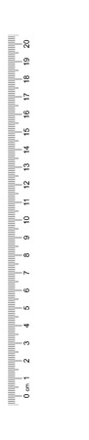
Trade Marketing & Retail.
How many accounts do we list in Trade Marketing ?
TM Don'ts
TM Do’s
KAM Selection criteria
Channel prioritization
Top 100
Top 200
Top 300
Use your budget for TM activity specifically
Key attributes for TM selection
Genuine Customers
Optimum level to manage
Business development and potential
Attract potential business development customers
Add customers through a selection process
Build the TM customer portfolio which can be managed with over stretching resources
Be aware of too less customers or too many customers
Successful companies managing TM keep the KAM customers focussed on the criteria at right.
Data Sharing
Selection
Parameters
Right Demographics
Selecting top accounts with a drag and drop function using a spread sheet is counter productive as the number is usually a product of a long list of accounts and a cut away point decides top account status
The qualifier in all 3 examples will be to use a qualification criteria mostly sales turnover which is not a great way to qualify your account.
Consumer access
Category engagement
Account engagement

Slide 32
Trade Marketing & Retail.
Self evaluation questions !
What is my brand strategy ?
My TM Tactics will be an extension of what my brand playbook research indicates
My choice of consumer profiling and selection of accounts will greatly improve my success rate.
Designing TM promotions , usually striking the right balance between the factors are Value , Communication ease , relevance and great mechanics
Engaging
Numeric distribution is % of outlets selling a particular identified product
Do I have a set of promotional tactics which address Habits , Usage , and unmet needs or do I need something more before I engage my consumer
Can I profile my accounts based on demographics , habits , and category engagement success probabilities
Where can I get the data to build a robust account selection plan
Which categories , what brands and what communication / promotions will strike the right balance with my target market.
Volume weighted distribution is % of outlets whose share of relevant $ sales is higher than their numeric distribution selling a particular identified product
Evaluating
It’s a matter of asking .
Engage the trade & profile the consumer
Develop a TM plan , align it with the brand plan
Engage the decision makers in the trade to get basic alignment , don’t surprise them.
Executing
Where do I get the data
Which accounts should I prioritize
What promotions should I develop
Which channels do I prioritize
Which categories do I engage
What products do I promote
www.upskilpro.com

Slide 33




Trade Marketing & Retail.
Segmenting Customers
The systematic assessment approach described in this chapter enables suppliers to build a portfolio view of their customers that drives many further insights, decisions and expectations about them, which is much more realistic and powerful than the key customer lists that many suppliers use.
High
Strategic Customers
Star Customers
Importance
Streamline Customers
Status Customers
Low
Low
Value
Value
High
Star Quadrant - investment for growth
Strategic Quadrant – strategic investment
Status Quadrant – proactive maintenance
Streamline Quadrant – management for cash.

Slide 34
Trade Marketing & Retail.
Aligning KAM to Brand Corporate Strategy
Brand positioning
Target audience
Brand identity.
Brand messaging
Brand experience
Brand architecture.
Fulfilling Corporate Strategy
Do
Key Customers can contribute anywhere from single digit to double digit accounts , aim for a sweet spot of neither too high or low as the list must be manageable
Your TM aspirants must be Business leaders in the chosen category or business or in the channel with a view to grow along with you
These TM aspirants will be able to make a contribution to your growth and delivery of your strategic vision .
A big customer need not necessarily become a KAM aspirant conversely a small account need not necessarily not become a KAM aspirant
Build the Customer portfolio using the critical qualifiers to make it to your list
Do Not
Predefine the TM list of customers
Add known accounts friendly to you
Add accounts will not be able to deliver your corporate strategy and vision
Brand Strategy
Brand positioning
Target audience
Brand identity.
Brand messaging
Brand experience
Brand architecture.
Trade Marketing
Accounts
Alignment with brand strategy
Aligns with TM account qualifications
Synergy
Segment Leaders
Channel Leaders
Rest of your
Accounts
Not necessarily aligned with your TM plan
They usually form the balance of the accounts

Slide 35
Trade Marketing & Retail
Any reseller in any channel is potentially a Trade Marketing account subject to agreed prioritization characteristics.
UpskilPRO e Institute for Sales & Marketing
Tools, Content & Templates
Hand built using experience & insight

