Slide 1
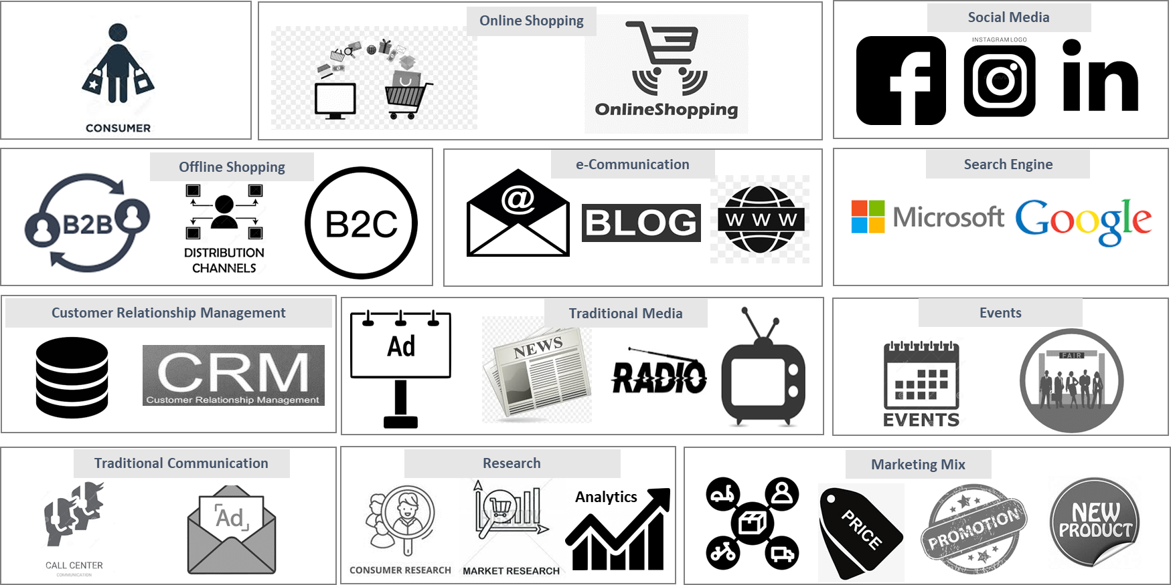
Marketing Landscape
Review your marketing landscape and align solutions to initiatives
UpskilPRO e Institute for Sales & Marketing
Tools, Content & Templates
Hand built using experience & insight

Slide 2
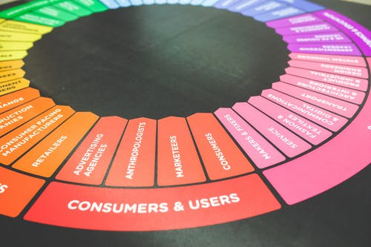
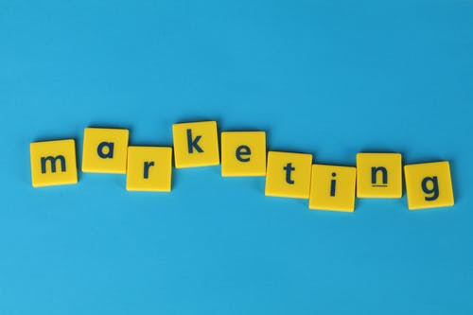
Created by
ex-Procter & Gamble, Rothmans, BAT, Gillette, Nokia,
Microsoft & 3M managers.
UpskilPRO tools are designed in easy-to-use solutions, all you need to do is download the tool and get to work immediately . All UpskilPRO material has taken 100’s of hours and many 1000’s of $ to build , all this expertise and content is brought to you for a fraction of the cost to help professionals enhance their capability.
core areas which are best suited to improve using our tools:
Subject matter expertise
Best practices
Analytical output & charting
Prioritization
Process
Making life simpler for
Sales & Marketing professionals.
Tools in one place to get 10X productive now.

Slide 3
Job Descriptions
Develop roles clearly and completely across varying levels of experience
Agreements
Draft your business agreements across a variety of areas
Templates
Templates are designed based gather information in a structured manner
KPI’s
Performance indicator, a quantifiable measure of performance over time versus a specific objective.
Content Modules
Best practice material in power point for use as a knowledge base in business training , planning and execution .
Strategic tools
These tools are recognised the world over in business schools, consulting firms and companies who plan strategically.
Gain a competitive edge using the best tools and techniques to build a better you .
Analytical Tools
Interactive excel tools on specific business areas based on your data inputs delivered in a workbook model with instructions.
Scorecards
Designed as functional or subject indicators across a variety off situations to enable performance of situational evaluation versus aligned standards.
Calculators
calculate the right ratios for businesses looking for benchmarks in a variety of situations
Assessments
Assessments are designed around specific areas to conduct reviews and will center around a benchmark reviewing individuals or functions
Checklists
Designed around achieving milestones in a sequential manner.
Research
Research tools for sales and marketing engagement

Slide 4
2017
2018
100’s of tools grouped in 12 categories, 50 tool types and 12 business functions in 1 place.
get 10X productive now !
Categories
Functions
Analytical Tools
Types
Business Development
Agreements
Advertising
Customer Acquisition
Margins
Partner Search
Reports
Category Management
Assessments
Agreements
Customer Management
Market Analysis
Persona Development
Retail Measurement
Channel Management
Content Modules
Analytics
Distribution
Market Development
Planning
Reviews
Distribution
Checklists
Barriers
Distributor Management
Market Research
Positioning
Sales Management
Distributor Management
Calculators
Business Reviews
Forecasting
Market Segmentation
Pricing
Scorecards
General Management
Job Descriptions
Business Intelligence
GAP Analysis
Market Size
Prioritization
Segmentation
Key Account Management
KPI’s
Channels
Go To Market
Marketing
Product Development
Six Sigma
Marketing
Research
Communication
Job Descriptions
Marketing Comms
Product Life Cycle
Socio Economic Classification
Marketing Operations
Strategic Tools
Competitive Evaluation
Key Account Plans
Merchandising
Profit & Loss
Territory Design
Sales Management
Scorecards
Competitive Intelligence
Management Summary
New Market Entry
Promotions
Trade Marketing
Shopper Marketing
Templates
Trade Marketing

Slide 5
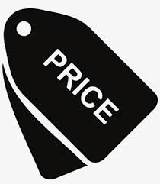
Marketing Landscape
Traditional & e marketing mix
We drafted a high-level view of the marketing landscape .
It is for the audience to view the whole perspective of Marketing specialties and the various segmentations within them.
Online Shopping
Social Media
Offline Shopping
e-Communication
Search Engine
Customer Relationship Management
Traditional Media
Events
Traditional Communication
Research
Marketing Mix
Analytics

Slide 6
Marketing Landscape
Four Major Trends Shaping The Marketing Landscape In 2020’s
We have given a general overview of Major trends shaping the marketing landscape . However, there will be many more specially when looked at vertically by industry, and for this we recommend additional researching.
Marketing leaders will become experts in balancing customer experience and business growth.
The line between B2B and B2C marketing will nearly disappear.
Artificial intelligence will continue to focus in on solving everyday challenges.
A single source of truth for customer data will become a reality.
The emergence of AI is inevitable , in fact it has already started making its way onto our Smart Phones are great examples of how AI has entered our lives .

Slide 7
Marketing Landscape
10 Digital Marketing Trends In 2020
Inform, entertain or inspire.
These are the top 10 trends we believe are and will influence Digital marketing this year , however for your industry there might be specificities which need to be taken in to account.
We recommend adapting this slide to your requirement.
Facebook has peaked .
Instagram is a Hit with the Kids
Social Media
Why not?
Video matters and is no longer an option
Good Content Matters
Email is Getting More Personalized
Omnichannel Marketing is Now Vital.
Content
Interactive Content Will Become Mainstream
Voice Interaction Continues Upward
Marketing in Messaging Apps Will Level-Up
Chatbots Will Dominate Customer Service
Engagement

Slide 8
Marketing Landscape
Advertising spend in Bn of US $ 2019
Comment 01
Comment 02
Comment 03
Comment 04
All figures are in Billions of US $
Source of information is CMO Spend survey 2019
Information is inclusive of all types of marketing spend
Marketing spend is estimated to be 11.2 % of revenue in 2019.

Slide 9
Marketing Landscape
Marketing spend by Industry 2019
Comment 01
All figures in % of spend on revenue 100 global companies .
Comment 02
Highest percentage spend ins the Retail industry .
Comment 03
Companies that sell more than 10 % of sales online continue to invest in the region of 13% on marketing .
As opposed to companies in a traditional sales model without sales online invest up to 10.5% on marketing
Comment 04
Source of information is the CMO spend survey

Slide 10
Created by
ex-Procter & Gamble, Rothmans, BAT, Gillette, Nokia,
Microsoft & 3M managers.
UpskilPRO tools are designed in easy-to-use solutions, all you need to do is download the tool and get to work immediately . All UpskilPRO material has taken 100’s of hours and many 1000’s of $ to build , all this expertise and content is brought to you for a fraction of the cost to help professionals enhance their capability.
core areas which are best suited to improve using our tools:
Subject matter expertise
Best practices
Analytical output & charting
Prioritization
Process
Making life simpler for
Sales & Marketing professionals.
Tools in one place to get 10X productive now.

Slide 11
Marketing Landscape
Review your marketing landscape and align solutions to initiatives
UpskilPRO e Institute for Sales & Marketing
Tools, Content & Templates
Hand built using experience & insight

