Slide 1

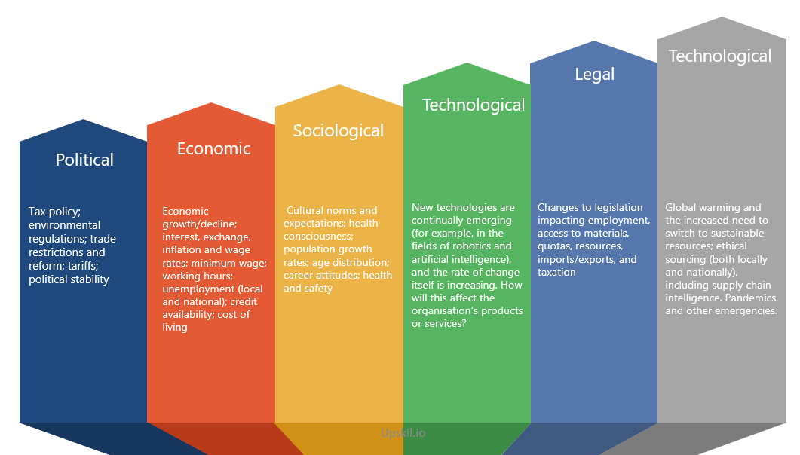
PESTLE Analysis
Analyse the factors that gives organisations a start to gain both an insight and an assimilation of the broader factors affecting an industry
UpskilPRO e Institute for Sales & Marketing
Tools, Content & Templates
Hand built using experience & Insight

Slide 2
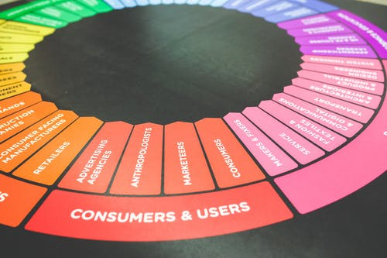



Created by
ex-Procter & Gamble, Rothmans, BAT, Gillette, Nokia,
Microsoft & 3M managers.
UpskilPRO tools are designed in easy-to-use solutions, all you need to do is download the tool and get to work immediately . All UpskilPRO material has taken 100’s of hours and many 1000’s of $ to build , all this expertise and content is brought to you for a fraction of the cost to help professionals enhance their capability.
core areas which are best suited to improve using our tools:
        Subject matter expertise
        Best practices
        Analytical output & charting
        Prioritization
        Process
Capability enhancement tools for
Consumer Marketing, Trade Marketing &
Sales excellence professionals.
Tools in one place to get 10X productive now.

Slide 3


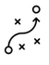



Job Descriptions
Develop roles clearly and completely across varying levels of experience
Agreements
Draft your business agreements across a variety of areas
Templates
Templates are designed based gather information in a structured manner
KPI’s
Performance indicator, a quantifiable measure of performance over time versus a specific objective.
Content Modules
Best practice material in power point for use as a knowledge base in business training , planning and execution .
Strategic tools
These tools are recognised the world over in business schools, consulting firms and companies who plan strategically.
Gain a competitive edge using the best tools and techniques to build a better you .
Analytical Tools
Interactive excel tools on specific business areas based on your data inputs delivered in a workbook model with instructions.
Scorecards
Designed as functional or subject indicators across a variety off situations to enable performance of situational evaluation versus aligned standards.
Calculators
calculate the right ratios for businesses looking for benchmarks in a variety of situations
Assessments
Assessments are designed around specific areas to conduct reviews and will center around a benchmark reviewing individuals or functions
Checklists
Designed around achieving milestones in a sequential manner.
Research
Research tools for sales and marketing engagement

Slide 4
2017
2018
100’s of tools grouped in 12 categories, 50 tool types and 12 business functions in 1 place.
get 10X productive now !
Categories
Functions
Analytical Tools
Types
Business Development
Agreements
Advertising
Customer Acquisition
Margins
Partner Search
Reports
Category Management
Assessments
Agreements
Customer Management
Market Analysis
Persona Development
Retail Measurement
Channel Management
Content Modules
Analytics
Distribution
Market Development
Planning
Reviews
Distribution
Checklists
Barriers
Distributor Management
Market Research
Positioning
Sales Management
Distributor Management
Calculators
Business Reviews
Forecasting
Market Segmentation
Pricing
Scorecards
General Management
Job Descriptions
Business Intelligence
GAP Analysis
Market Size
Prioritization
Segmentation
Key Account Management
KPI’s
Channels
Go To Market
Marketing
Product Development
Six Sigma
Marketing
Research
Communication
Job Descriptions
Marketing Comms
Product Life Cycle
Socio Economic Classification
Marketing Operations
Strategic Tools
Competitive Evaluation
Key Account Plans
Merchandising
Profit & Loss
Territory Design
Sales Management
Scorecards
Competitive Intelligence
Management Summary
New Market Entry
Promotions
Trade Marketing
Shopper Marketing
Templates
Trade Marketing

Slide 5
PESTLE Analysis
Analyse the factors that gives organisations a start to gain both an insight and an assimilation of the broader factors affecting an industry

Slide 6
PESTLE Analysis
Category Drivers
A PESTLE analysis is a framework to analyse the key factors (Political, Economic, Sociological, Technological, Legal and Environmental) influencing an organisation from the outside.
The analysis is flexible, so organisations can use it in a range of different scenarios.

Slide 7
PESTLE Analysis
Why do a pestle analysis ?
Why do a PESTLE analysis?
A PESTLE analysis helps an organisation to understand the market and business position better, plan strategically, and conduct market research in new and existing markets.
The broader framework and alignment:
Encourages strategic thinking and helps you evaluate how your strategy fits into the broader environment
Provides an overview of the crucial external influences on the organization
Allows leaders to make more decisive and knowledgeable decisions
Who is involved in a PESTLE analysis?
A PESTLE analysis is useful in all industries at the strategic, departmental, and project level to assess current and future markets.
Well planned organisations use it as a key input for
Planning
Marketing
Organizational change,
Business and product development,
Research planning and analysis.
PESTLE’s are conducted as a strategic planning process and is used to help shape the future direction.
Senior Managers, C-Level executive, Leaders, major stakeholders, partners, consultants and major clients all should be considered as part of the group which creates the analysis.

Slide 8
PESTLE Analysis
Category Drivers
Category Drivers
A PESTLE analysis is an audit of six external influences on an organisation:
By analysing the 6 factors, it gives organisations a start to gain both an insight and an assimilation of the broader factors affecting an industry .
There are bound to be differences of opinion when conducting this exercise , and we recommend the drivers be broadened to any insights affecting the overall industry and build them into your factors to weigh .
Almost all organisations can gain insight into the external influences which may impact their strategy and business decisions. It allows leadership to assess any risks specific to their industry and organisation, and use that knowledge to inform their decisions to the stakeholders.
.
The term PESTLE has been used regularly in the last decade or so and its true history is difficult to establish an insight into the state of the impacting 6 key drivers outlined on the left
Various other similar acronyms have been used include STEP, PEST, and STEEPLE (where the extra E stands for Ethical).
Political
Economic
Sociological
Technological
Legal
Environmental

Slide 9
PESTLE Analysis
Category Drivers
Technological
Legal
Technological
Sociological
Political
Economic
Tax policy; environmental regulations; trade restrictions and reform; tariffs; political stability
Economic growth/decline; interest, exchange, inflation and wage rates; minimum wage; working hours; unemployment (local and national); credit availability; cost of living
Cultural norms and expectations; health consciousness; population growth rates; age distribution; career attitudes; health and safety
New technologies are continually emerging (for example, in the fields of robotics and artificial intelligence), and the rate of change itself is increasing. How will this affect the organisation’s products or services?
Changes to legislation impacting employment, access to materials, quotas, resources, imports/exports, and taxation
Global warming and the increased need to switch to sustainable resources; ethical sourcing (both locally and nationally), including supply chain intelligence. Pandemics and other emergencies.

Slide 10
PESTLE Analysis
Category Drivers
POLITICAL OR POLITICALLY
influenced areas or factors that could impact the business organization
Government policy, political stability or instability, bureaucracy, corruption, foreign trade policy, tax policy, trade restrictions, labour/environmental/copyright/consumer protection laws, competition regulation, funding grants & initiatives, etc.
Questions to review:
What government policies or political groups could be beneficial or detrimental to our success?
Is the political environment stable or likely to change?

Slide 11
PESTLE Analysis
Category Drivers
ECONOMIC FACTORS
Overall economic forces that could affect what you’re trying to do.
Consider economic trends, evaluate growth rates, review industry growth, understand seasonal factors like taxation, inflation, interest rates, international exchange rates, International trade, labour costs, consumer disposable income, unemployment rates, availability of credit, monetary policies, raw material costs, etc.
Areas to review:
What economic factors will impact on us moving forward?
Does the current economic performance affect us?
How does each economic factor impact our pricing, revenues, and costs?

Slide 12
PESTLE Analysis
Category Drivers
SOCIAL FACTORS
Social aspects, attitudes, and trends that influence your business and target market.
Attitudes and shared beliefs about a range of factors including health, work, leisure, money, customer service, imports, religion, cultural taboos, the environment; population growth and demographics, family size/structure, immigration/emigration, lifestyle trends, etc.
Areas to review:
How do our consumer’s values and beliefs impact on their buying habits?
How does human behaviour or cultural trends play a role in our business?

Slide 13
PESTLE Analysis
Category Drivers
TECHNOLOGICAL FACTORS
Technology that can affect the way you make, distribute, and communicate your products and services.
Technology and communications infrastructure, consumer access to technology, emerging technologies, automation, legislation around technology, research and innovation, intellectual property regulation, competitor technology and development, technology incentives, etc.
Areas to review:
What innovations and technological advancements are available or on the horizon?
How might they affect our operations?

Slide 14
PESTLE Analysis
Category Drivers
LEGAL FACTORS
Current and future legal and regulatory requirements impacting on the business.
laws regarding consumer protection, labour, health & safety, antitrust, intellectual property, data protection, tax and discrimination; international and domestic trade regulations/restrictions, advertising standards, product labelling and safety standards, etc.
Areas to review:
What regulations and laws apply to our business?
Do they help or hinder our business?
Do we understand the laws across all our markets?

Slide 15
PESTLE Analysis
Category Drivers
ENVIRONMENTAL FACTORS
Environmental forces impacting your businesses and/or customer’s geographical location, the surrounding environment, and natural resources used by your organization.
Weather, climate change, your carbon footprint, environmental regulations, pollution laws and targets, recycling and waste management policies, endangered species, support for renewable energy, etc.
Areas to review:
How does our physical environment affect us and vice versa?
What are the effects of climate, weather or geographical location?
Are we prepared for future environmental targets?

Slide 16
PESTLE Analysis
Category Drivers
P
E
S
T
E
L
Political
Economic
Social
Technological
Environmental
Legal
Stringent measures
Protection of copy rights
Patent legislation
Regulatory fees
Involvement in Labour practices
Conflict with customers that have high demand and occupy a large share of the business contribution or economy
Fragmented market
Declining customer share of wallet
Price pressure
Higher taxes
Higher duties
Reliance on manufacturers abroad
Shorter life cycle leading to higher investments
Lower birth rate
Lowe per capita consumption and spending
Product life cycle is shorter leading to difficulty in recovering investments
Unemployment
Emerging trends in ageing population and declining childbirth
Pensionable age increased
Wage rates declining
Low copyright or Trademark protection
Licensing
Intense competition from low-cost countries
Technology gaps due to licencing or procedural delays
Raw material imports for technology specific production ( Rare earths )
Import licensing
Raw material shortage
Pollution & Greenhouse effect
Carbon reduction
Carbon footprint
Environmental legislation
Geographical location
Health & Safety
Equal opportunities
Consumer rights
Product labelling legislation
Labour laws
Competitive legislation
Combative legislation
Protectionism
Safety standards
Product safety and recall
Advertising standards
Category Drivers
You can also use the excel tool for PESTLE analysis found under serial no 6008

Slide 17

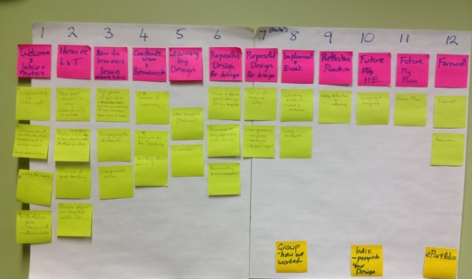

PESTLE Analysis
Category Drivers
Brainstorm
Group
Rate
Share
Group together and brainstorm each idea around the 6 steps
PESTLE
Alternately you can break out in splinter groups and regroup at the end to get a bigger holistic view without having groups influenced
Get the groups idea and start grouping them into smaller sections of a similar nature
This step will take time , use a Flip chart with a stick end to walk around the room and place them in sections which are similar in nature
Individually rate each of the ideas based on the level of impact you think they will have on your business.
Discuss any significant discrepancies in the ratings. Ask participants to explain their rationale and ideally, have them re-rate that idea based on discussions. The more aligned you can get people’s thinking around each factor, the better understanding everyone will have about challenges facing other parts of the organization, and the more focused your strategic planning will be.
The completed template gives a good overview of the status of the business. Distribute the PESTLE Analysis to relevant stakeholders. Use the report to monitor progress and as a foundation for future reviews.
Repeat the PESTLE analysis at regular intervals to stay on top of changes in the macro environment and keep your strategies and plans up to date.
High Relevance
Relevant
Low relevance
No Relevance
You can also use the excel tool for PESTLE analysis found under serial no 6008

Slide 18
PESTLE Analysis
Category Drivers
P
E
S
T
E
L
Political
Economic
Social
Technological
Environmental
Legal
Category Drivers
Please enter your reference and comments for all 6 areas of the PESTEL Analysis
You can also use the excel tool for PESTLE analysis found under serial no 6008

Slide 19
PESTLE Analysis
Analyse the factors that gives organisations a start to gain both an insight and an assimilation of the broader factors affecting an industry
UpskilPRO e Institute for Sales & Marketing
Tools, Content & Templates
Hand built using experience & Insight

