Slide 1
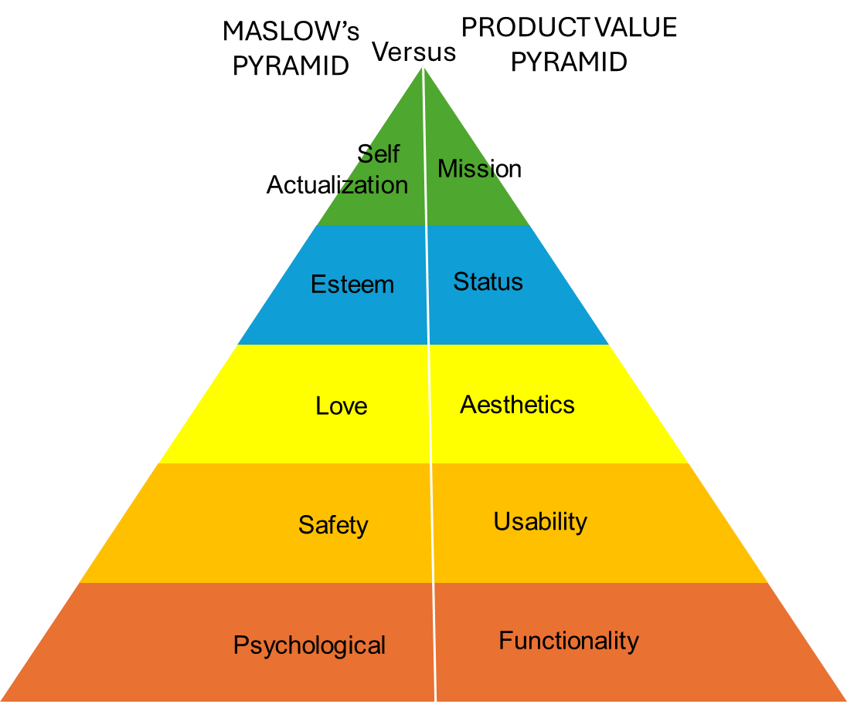
Comphrensive Sales Training .
Identifying Customer Needs
Analyzing customer feedback is essential for understanding customer needs and improving products and services.
Monitoring & Adapting.
Module 5
UpskilPRO e Institute for Sales & Marketing
Tools, Content & Templates
Hand built using experience & insight

Slide 2
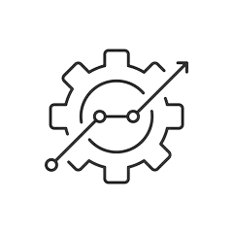
Job Descriptions
Develop roles clearly and completely across varying levels of experience
Agreements
Draft your business agreements across a variety of areas
Templates
Templates are designed based gather information in a structured manner
KPI’s
Performance indicator, a quantifiable measure of performance over time versus a specific objective.
Content Modules
Best practice material in power point for use as a knowledge base in business training , planning and execution .
Strategic tools
These tools are recognised the world over in business schools, consulting firms and companies who plan strategically.
Gain a competitive edge using the best tools and techniques to build a better you .
Analytical Tools
Interactive excel tools on specific business areas based on your data inputs delivered in a workbook model with instructions.
Scorecards
Designed as functional or subject indicators across a variety off situations to enable performance of situational evaluation versus aligned standards.
Calculators
calculate the right ratios for businesses looking for benchmarks in a variety of situations
Assessments
Assessments are designed around specific areas to conduct reviews and will center around a benchmark reviewing individuals or functions
Checklists
Designed around achieving milestones in a sequential manner.
Research
Research tools for sales and marketing engagement

Slide 3
Identifying Customer Needs
Module 5
Monitoring & Adapting
www.upskilpro.com

Slide 4
Module 5 - Summary .
In a rapidly evolving market, it is crucial for businesses to continuously monitor and adapt to changing customer needs. This involves staying updated on industry trends and continually assessing and adapting to customer needs.

Slide 5
Module 5 - Identifying Customer needs.
Learning Objective: it is crucial for businesses and stakeholders to continuously monitor and adapt to changing customer needs , this module will help you look at the key areas for development.
Understanding Customer Needs
Techniques for Identifying Needs
Analysing Customer Feedback
Aligning Solutions to Customer
Monitoring and Adapting to Changing Needs
Identifying Customer Needs
Articulating Customer Needs
Benefits of Needs-Based Selling
Impact on Customer Satisfaction and Loyalty
Asking open-ended questions
Active listening
Integration of techniques
Needs assessment tools.
Collecting feedback
Organising & categorizing
Using feedback
Drawing Insights
Implementing changes.
Executing changes
Customizing products and services
Presenting tailored solutions
Staying updated on industry trends
Continually assessing and adapting to customer needs
www.upskilpro.com

Slide 6
Staying updated on industry trends
www.upskilpro.com

Slide 7
Module 5 - techniques for identifying needs.
Collecting feedback.
Formula for Collecting Feedback
"Identify Purpose + Select Method + Design Questions + Collect Responses + Analyze Data + Implement Changes"
www.upskilpro.com

Slide 8
Module 5 - techniques for identifying needs.
Customizing products & services.
Attending Industry Events
Conferences and Trade Shows: Participate in industry conferences, trade shows, and exhibitions to gain insights into the latest developments and innovations.
Webinars and Online Events: Attend webinars and online events to stay informed about new technologies, practices, and trends.
Conducting Market Research
Industry Reports: Regularly review industry reports from reputable sources to understand market dynamics and emerging trends.
Competitor Analysis: Continuously monitor competitor activities, product launches, and marketing strategies to identify shifts in the market.
Engaging with Industry Networks
Professional Associations: Join professional associations and industry groups to network with peers and exchange knowledge.
Online Communities: Participate in online forums, social media groups, and professional networks to stay connected with industry experts and influencers.
www.upskilpro.com

Slide 9
Continually Assessing and Adapting to Customer Needs

Slide 10
Module 5 - techniques for identifying needs.
Continually assessing and adapting.
Analyzing Customer Interactions
Customer Service Data: Analyze data from customer service interactions to identify common issues and areas for improvement.
Social Media Monitoring: Monitor social media platforms for customer comments, reviews, and feedback about your products and services.
Implementing Continuous Feedback Mechanisms
Surveys and Polls: Conduct regular surveys and polls to gather up-to-date feedback from customers.
Feedback Forms: Use feedback forms on websites and apps to collect ongoing customer input.
Utilizing Advanced Analytics
Predictive Analytics: Use predictive analytics to forecast future customer needs and preferences based on historical data.
Sentiment Analysis: Employ sentiment analysis tools to gauge customer sentiment and identify emerging trends in customer attitudes.
www.upskilpro.com

Slide 11
Developing an adaptive strategy

Slide 12
Module 5 - techniques for identifying needs.
Developing an adaptive strategy .
Strategic Planning
Scenario Planning: Develop multiple scenarios to anticipate potential changes in customer needs and market conditions.
Flexibility in Planning: Ensure that strategic plans are flexible and can be adjusted based on new insights and data.
Cross-Functional Collaboration
Interdepartmental Meetings: Hold regular meetings with cross-functional teams to discuss customer feedback and industry trends.
Unified Action Plans: Develop unified action plans that involve all relevant departments in adapting to changing customer needs.
www.upskilpro.com

Slide 13
Adaptive measures

Slide 14
Module 5 - techniques for identifying needs.
Adaptive measures.
Customizing Offerings
Personalized Solutions: Continuously tailor products and services to meet the evolving needs of different customer segments.
Dynamic Pricing: Implement dynamic pricing strategies that reflect changes in customer demand and market conditions.
Agile Development
Incremental Updates: Implement incremental updates to products and services based on ongoing customer feedback.
Rapid Prototyping: Use rapid prototyping to quickly develop and test new features or products that address emerging customer needs.
www.upskilpro.com

Slide 15
Implementing tailored solutions.

Slide 16
Module 5 - techniques for identifying needs.
Implementing tailored solutions.
Tracking Key Performance Indicators (KPIs)
Customer Satisfaction: Regularly measure customer satisfaction scores to assess the impact of adaptive measures.
Retention Rates: Monitor customer retention rates to evaluate the effectiveness of changes in meeting customer needs.
www.upskilpro.com

Slide 17
Monitoring & measuring impact.

Slide 18
Module 5 - techniques for identifying needs.
Monitoring & measuring impact.
Collecting and Analyzing Feedback Post-Implementation
Post-Change Surveys: Conduct surveys after implementing changes to gather customer feedback on the effectiveness of the adaptations.
Performance Reviews: Hold performance review sessions to analyze the impact of changes on overall business performance.
Performance Measurement
Key Metrics: Identify key performance metrics to measure the success of the tailored solution in meeting customer needs.
Customer Feedback: Collect feedback from customers to assess their satisfaction with the customized solution.
.
www.upskilpro.com

Slide 19
Module 5 - techniques for identifying needs.
Summary.
Continuous Improvement
www.upskilpro.com

Slide 20
Module 5 - techniques for identifying needs.
Continuous improvement & innovation.
Encouraging a Culture of Innovation
Employee Empowerment: Encourage employees at all levels to contribute ideas for improving products and services.
Innovation Programs: Implement programs that reward innovative ideas and solutions that enhance customer satisfaction and business performance.
Iterative Improvement
Continuous Feedback Loop: Establish a continuous feedback loop to gather insights and make ongoing improvements to products and services.
Iterative Testing: Regularly test new ideas and solutions in small batches to validate their effectiveness before full-scale implementation.
www.upskilpro.com

Slide 21
Module 5 - techniques for identifying needs.
Summary.
Conclusion
Monitoring and adapting to changing customer needs is a continuous and dynamic process that requires staying updated on industry trends and continually assessing and adapting to customer needs.
www.upskilpro.com

Slide 22
Comphrensive Sales Training .
Identifying Customer Needs
Analyzing customer feedback is essential for understanding customer needs and improving products and services.
Solutions alignment.
Module 5
UpskilPRO e Institute for Sales & Marketing
Tools, Content & Templates
Hand built using experience & insight

