Slide 1
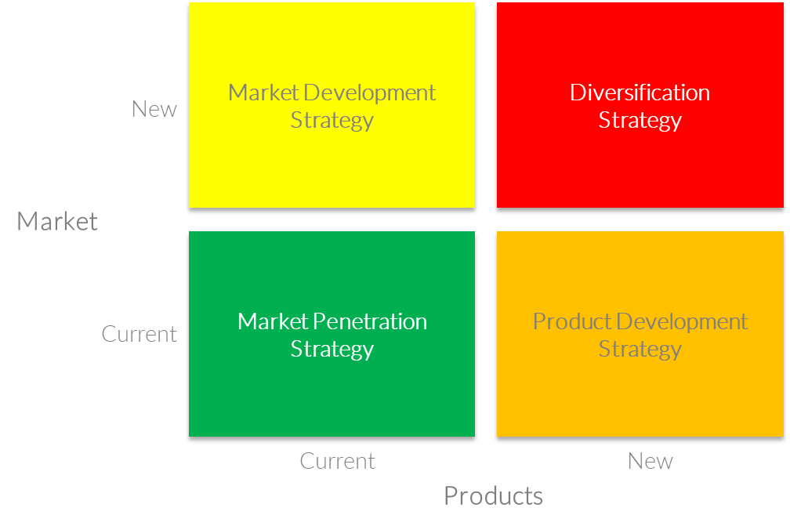
Ansoff’s Growth Matrix
Analyze and plan strategies for growth
UpskilPRO e Institute for Sales & Marketing
Tools, Content & Templates
Hand built using experience & Insight

Slide 2
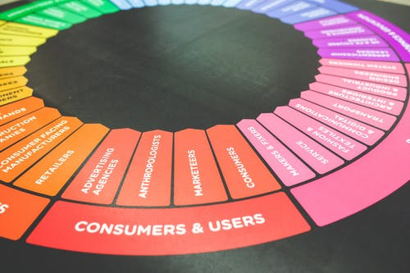
Created by
ex-Procter & Gamble, Rothmans, BAT, Gillette, Nokia,
Microsoft & 3M managers.
UpskilPRO tools are designed in easy-to-use solutions, all you need to do is download the tool and get to work immediately . All UpskilPRO material has taken 100’s of hours and many 1000’s of $ to build , all this expertise and content is brought to you for a fraction of the cost to help professionals enhance their capability.
core areas which are best suited to improve using our tools:
Subject matter expertise
Best practices
Analytical output & charting
Prioritization
Process
Capability enhancement tools for
Consumer Marketing, Trade Marketing &
Sales excellence professionals.
Tools in one place to get 10X productive now.

Slide 3
Job Descriptions
Develop roles clearly and completely across varying levels of experience
Agreements
Draft your business agreements across a variety of areas
Templates
Templates are designed based gather information in a structured manner
KPI’s
Performance indicator, a quantifiable measure of performance over time versus a specific objective.
Content Modules
Best practice material in power point for use as a knowledge base in business training , planning and execution .
Strategic tools
These tools are recognised the world over in business schools, consulting firms and companies who plan strategically.
Gain a competitive edge using the best tools and techniques to build a better you .
Analytical Tools
Interactive excel tools on specific business areas based on your data inputs delivered in a workbook model with instructions.
Scorecards
Designed as functional or subject indicators across a variety off situations to enable performance of situational evaluation versus aligned standards.
Calculators
calculate the right ratios for businesses looking for benchmarks in a variety of situations
Assessments
Assessments are designed around specific areas to conduct reviews and will center around a benchmark reviewing individuals or functions
Checklists
Designed around achieving milestones in a sequential manner.
Research
Research tools for sales and marketing engagement

Slide 4
2017
2018
100’s of tools grouped in 12 categories, 50 tool types and 12 business functions in 1 place.
get 10X productive now !
Categories
Functions
Analytical Tools
Types
Business Development
Agreements
Advertising
Customer Acquisition
Margins
Partner Search
Reports
Category Management
Assessments
Agreements
Customer Management
Market Analysis
Persona Development
Retail Measurement
Channel Management
Content Modules
Analytics
Distribution
Market Development
Planning
Reviews
Distribution
Checklists
Barriers
Distributor Management
Market Research
Positioning
Sales Management
Distributor Management
Calculators
Business Reviews
Forecasting
Market Segmentation
Pricing
Scorecards
General Management
Job Descriptions
Business Intelligence
GAP Analysis
Market Size
Prioritization
Segmentation
Key Account Management
KPI’s
Channels
Go To Market
Marketing
Product Development
Six Sigma
Marketing
Research
Communication
Job Descriptions
Marketing Comms
Product Life Cycle
Socio Economic Classification
Marketing Operations
Strategic Tools
Competitive Evaluation
Key Account Plans
Merchandising
Profit & Loss
Territory Design
Sales Management
Scorecards
Competitive Intelligence
Management Summary
New Market Entry
Promotions
Trade Marketing
Shopper Marketing
Templates
Trade Marketing

Slide 5
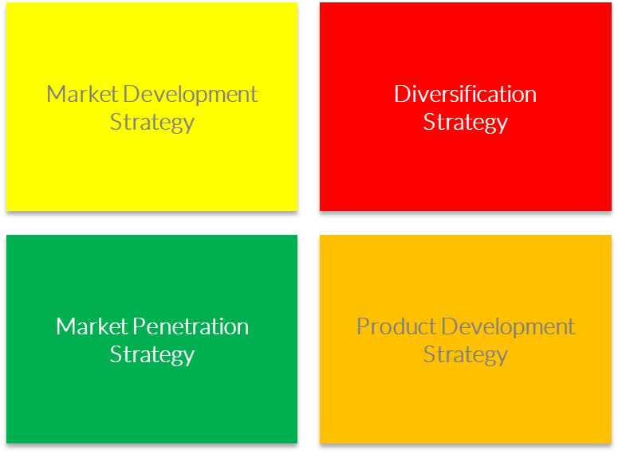
Ansoff’s Growth Matrix
Analyze and plan strategies for growth

Slide 6
Ansoff’s Matrix
Topic – Strategy Planning Tool
A strategy planning tool that links an organisations marketing strategy with its general strategic direction
1
2
3
4
5
Risks inherent with a market strategy and their management
4 Ways that an increase in market penetration can be achieved
Three Approaches for a brand extension that can maximise the probability of success while minimizing the risks
Three Methods organisations can use to diversify to enter new markets and new categories
Develop a strategy to improve market position

Slide 7
Ansoff’s Matrix
Topic – Strategy Planning Tool
Management reviews business growth opportunities under 4 distinct possibilities as part of their planning process
Assess the organization's internal capabilities and how it can respond to external forces .
Assess the organization's external environment
External Environment
Internal response capability
Analyze
Assess
Definition development of the organization
Aid
Assist
Implementation of the organization’s strategy.
Strategy Implementation
Strategy definition

Slide 8
Ansoff’s Matrix
Strategy Planning Tool
Management reviews business growth opportunities under 4 distinct possibilities as part of their planning process
Market Development Strategy
Diversification
Strategy
Develop new products in your existing markets
Develop new products in new markets
New
Market
Market Penetration
Strategy
Product Development Strategy
Develop new markets for current products
Gain more market share with your current products, in your current markets
Current
Current
Products
New

Slide 9
Ansoff’s Matrix
Strategy Planning Tool
Diversification
In diversification an organization tries to grow its market share by introducing new offerings in new markets. It is the most risky strategy because both product and market development is required.
Related Diversification— there is relationship and, therefore, potential synergy, between the firms in existing business and the new product/market space. Concentric diversification, and (b) Vertical integration.
Unrelated Diversification: This is otherwise termed conglomerate growth because the resulting corporation is a conglomerate, i.e. a collection of businesses without any relationship to one another. A strategy for company growth by starting up or acquiring businesses outside the company’s current products and markets.
Diversification consists of two quadrant moves so is deemed the riskiest growth option.
Market development
In market development strategy, a firm tries to expand into new markets (geographies, countries etc.) using its existing offerings and also, with minimal product/services development.
This can be accomplished by:
Different customer segments
Industrial buyers for a good that was previously sold only to the households;
New areas or regions of the country
Foreign markets.
This strategy is more likely to be successful where:
The firm has a unique product technology it can leverage in the new market
It benefits from economies of scale if it increases output
The new market is not too different from the one it has experience of
The buyers in the market are intrinsically profitable.
This additional quadrant move increases uncertainty and thus increases the risk further.
Product development
In product development strategy, a company tries to create new products and services targeted at its existing markets to achieve growth. This involves extending the product range available to the firm's existing markets. These products may be obtained by:
Investment in research and development of additional products;
Acquisition of rights to produce someone else's product;
Buying in the product and “badging” it as one’s own brand;
Joint development with ownership of another company who need access to the firm's distribution channels or brands.
This also consists of one quadrant move so is riskier than Market penetration and a similar risk as Market development.
Market penetration
In market penetration strategy, the organization tries to grow using its existing offerings (products and services) in existing markets. In other words, it tries to increase its market share in current market scenario. This involves increasing market share within existing market segments. This can be achieved by selling more products or services to established customers or by finding new customers within existing markets. Here, the company seeks increased sales for its present products in its present markets through more aggressive promotion and distribution.
This can be accomplished by:
Price decrease
Increase in promotion and distribution support
Acquisition of a rival in the same market
Modest product refinements
This is the least risky growth option.

Slide 10
Ansoff’s Matrix
Topic – Strategy Planning Tool
The Ansoff Growth matrix assists management to consider 4 key strategic options and their respective risk
Low risky
High risk
Diversification is the riskiest of the four options, because you're introducing a new, unproven product into an entirely new market that you may not fully understand.
With Market Development, you're putting an existing product into an entirely new market. You can do this by finding a new use for the product, or by adding new features or benefits to it.
Market Development Strategy
Diversification
Strategy
New
Market
Market Penetration
Strategy
Product Development Strategy
Product Development is slightly riskier than Market Penetration, because you're introducing a new product into your existing market.
Market Penetration is the safest of the four options. Here, you focus on expanding sales of your existing product in your existing market: you know the product works, and the market holds few surprises for you.
Current
Current
New
Products

Slide 11
Ansoff’s Matrix
Market Penetration Strategy
This strategy works on the basis that you are in a market and are required to increase sales into the same market to increase market share , in turn this presents the lowest risk as you exist in the market and have access to the market channels and distribution points .
To implement this strategy there are 4 ways
Growth
Market Penetration Strategy
Market Penetration
Maximize current product sale to current market
Gain Market share
Retain / Increase Product Market share
Strategy
Low risk
Dominate growth markets
Force out competitors
In this scenario it involves selling more to current consumers who are in the same marketing environment , in many ways this means selling more to the same segmented customer who has been targeted by you in the first place.
A key determining factor for continuing success is to keep the same known strategy which delivered the initial success constant avoiding risk .
This strategy is low risk as it uses the same factors that gave you current success and avoids spending any more than required to maintain share
Increase existing consumer usage

Slide 12
Ansoff’s Matrix
Market Penetration Strategy
This strategy works on the basis that you are in a market and are required to increase sales into the same market to increase market share , in turn this presents the lowest risk as you exist in the market and have access to the market channels and distribution points .
Capability and possibilities
Target using a mix of Pricing, Advertising & Sales promotion
Market Penetration Strategy
Growth markets & Dominance
Target new demographics
Changing market dynamics
New geographies / channels
Aggressive promotional campaigns
Supporting pricing strategy
Basically your strategy is based on take share as a strategy
Maintain / Increase Product Market share
Secure / Dominate growth markets
Restructure / Force out competitors
In mature or congested markets
Make the market unattractive for existing competitors
Few opportunities exist to take share
Communication saturation
Basically your strategy is based on take share.
Increase existing consumer usage
Educate existing consumers to use the product more frequently , loyalty schemes and adapting consumption based on product design are some of the ways used .
In toothpastes for example it’s a known fact that the diameter of the toothpaste tube/outlet was increased to facilitate increased consumption of toothpaste

Slide 13
Ansoff’s Matrix
Market Development Strategy
A market development strategy is usually all encompassing , it depends on the brand owner which levers of growth to deploy .
To implement this strategy there are 4 ways
New Markets
New countries , new states , new continents, any market new apart from the home market is new , the method of entry is left solely to the brand owner as choice
Market Development Strategy
New Products
Repackaging
New Products
New Formulations
New usage recommendations
New Markets
New Products / Formulation / Packaging
New Channels
New channel entry
New products for new channels
New Formulation for new channels
New packaging for new channels
New channels
New market segment / Pricing
New formulation
New market segments is a mix of demographic and product solutions
What it means is the product needs to be adapted to gaining entry into a new market segment , through the careful application of demographics / product design / pricing and mix management .

Slide 14
Ansoff’s Matrix
Product Development Strategy
R&D
R&D helps create new technologies and new product applications
Helps create IP
Creates technology platforms that have a competitive edge
Product Development Strategy
Customer needs
Customer insights
Consumer insights
Assisted learning of needs
Market data and analytics
Based on R & D
Customer needs assessed
Brand Extension
Extending Brand names
Category extensions
Specific brand positioning
Extending brand positioning into new areas
The subject of brand extensions is a matter of great importance as the risk tends to be high in case of non acceptance and damage to the parent brand
Merely slapping on a Brand logo is not brand extension
Clear path for brand positioning and extension
Brand Extension
Hard to predict
Defies Logic at times
Must be clear for a consumer

Slide 15
Ansoff’s Matrix
Diversification strategy
Diversification strategy should centre around new products for Same markets , and New products eventually for new markets , in new markets an acquisition strategy may bear quicker results as the product or solution has been tested and possibly accepted
Diversification
Full diversification
Backward
Diversification
Forward diversification
Highest risk and requires a large amount of investment and time
This stage is one step before your current stage and in many cases adds value as it becomes part of the value chain.
This stage is one stage ahead of your current stage and may require careful assessment as it while offering a quicker way to market needs capability and relevance assessment
Risk assessment should be assessed under a completely open evaluation system for understanding the fair market risks , and must bear the 2 elements A) Risk & B) Reward.
Diversification Strategy
Access to Capital
Capital remains the driving force for any industry and the project plan will require full finding to a ration of 2X in some cases due to project overruns.
Risk assessment
Access to Capital
Upsides and Gains
A well written project plan for diversification will have an Upside and Downsides for reference and based on the level of inputs will offer good insight into return on investment
Clear expectation of gains and upsides

Slide 16
Ansoff’s Growth Matrix
Analyze and plan strategies for growth
UpskilPRO e Institute for Sales & Marketing
Tools, Content & Templates
Hand built using experience & Insight

