Slide 1
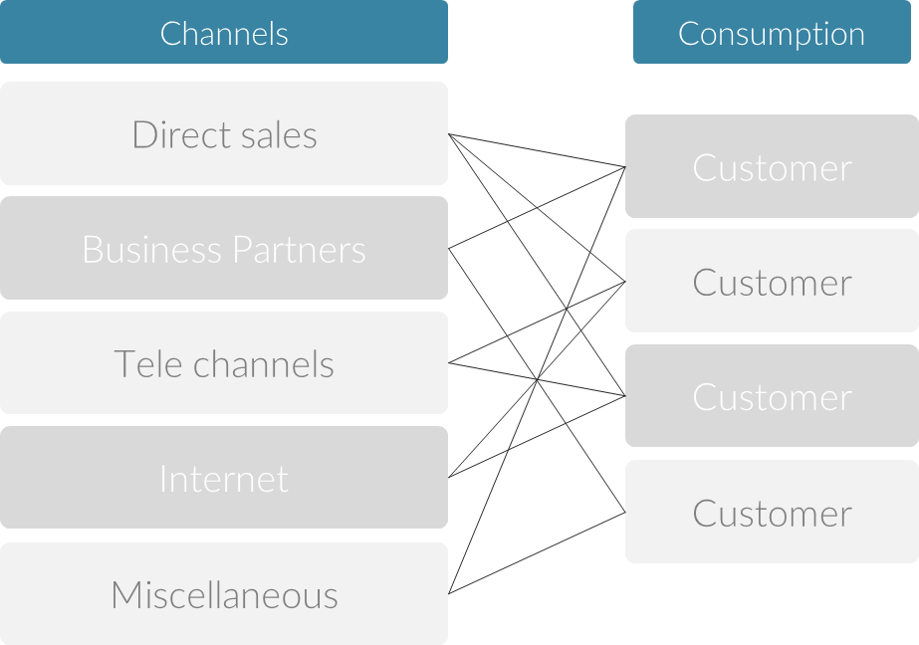
Scorecard – Channel Distribution
Channel Evaluation Methods
UpskilPRO e Institute for Sales & Marketing
Tools, Content & Templates
Hand built using experience & insight

Slide 2
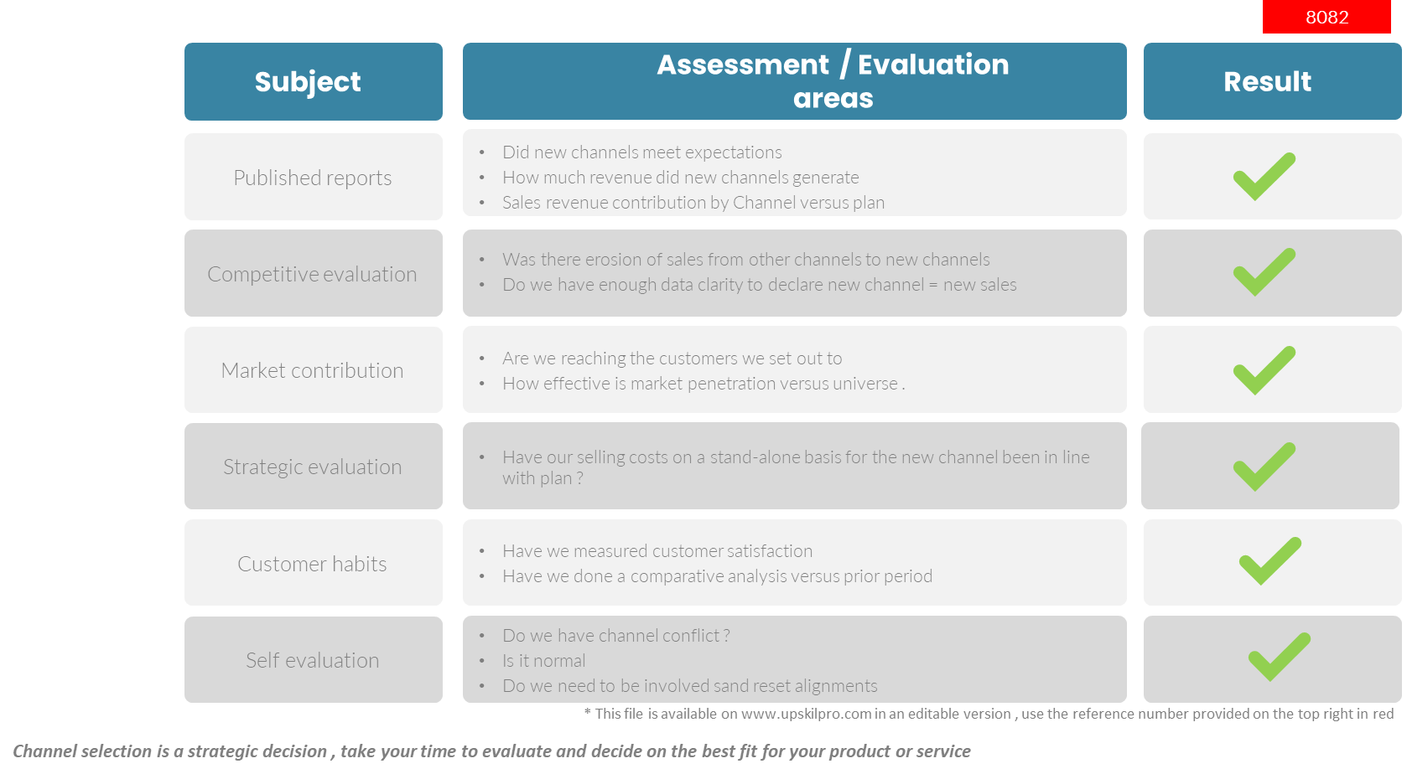
Channels of Distribution
Scorecard – Channel evaluation methods
3004

Slide 3
Scorecard – Channel Distribution
Channel Evaluation Methods
UpskilPRO e Institute for Sales & Marketing
Tools, Content & Templates
Hand built using experience & insight

