Slide 1

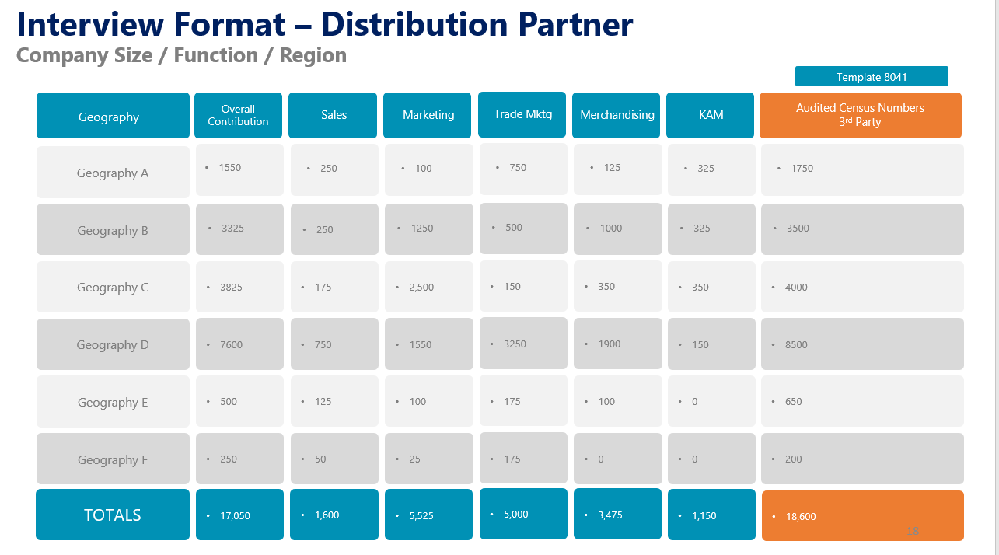
Distributor Interviews
Interview Format
Covers all aspects of interviewing the potential channel / distribution partner from relevant angles,
UpskilPRO e Institute for Sales & Marketing
Tools, Content & Templates
Hand built using experience & Insight

Slide 2
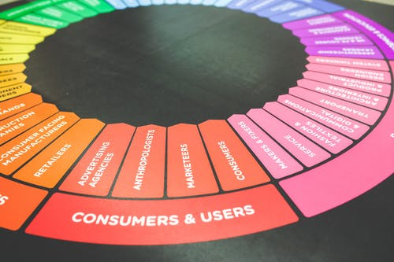



Created by
ex-Procter & Gamble, Rothmans, BAT, Gillette, Nokia,
Microsoft & 3M managers.
UpskilPRO tools are designed in easy-to-use solutions, all you need to do is download the tool and get to work immediately . All UpskilPRO material has taken 100’s of hours and many 1000’s of $ to build , all this expertise and content is brought to you for a fraction of the cost to help professionals enhance their capability.
core areas which are best suited to improve using our tools:
        Subject matter expertise
        Best practices
        Analytical output & charting
        Prioritization
        Process
Making life simpler for
Sales & Marketing professionals.
Tools in one place to get 10X productive now.

Slide 3


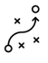



Job Descriptions
Develop roles clearly and completely across varying levels of experience
Agreements
Draft your business agreements across a variety of areas
Templates
Templates are designed based gather information in a structured manner
KPI’s
Performance indicator, a quantifiable measure of performance over time versus a specific objective.
Content Modules
Best practice material in power point for use as a knowledge base in business training , planning and execution .
Strategic tools
These tools are recognised the world over in business schools, consulting firms and companies who plan strategically.
Gain a competitive edge using the best tools and techniques to build a better you .
Analytical Tools
Interactive excel tools on specific business areas based on your data inputs delivered in a workbook model with instructions.
Scorecards
Designed as functional or subject indicators across a variety off situations to enable performance of situational evaluation versus aligned standards.
Calculators
calculate the right ratios for businesses looking for benchmarks in a variety of situations
Assessments
Assessments are designed around specific areas to conduct reviews and will center around a benchmark reviewing individuals or functions
Checklists
Designed around achieving milestones in a sequential manner.
Research
Research tools for sales and marketing engagement

Slide 4
2017
2018
100’s of tools grouped in 12 categories, 50 tool types and 12 business functions in 1 place.
get 10X productive now !
Categories
Functions
Analytical Tools
Types
Business Development
Agreements
Advertising
Customer Acquisition
Margins
Partner Search
Reports
Category Management
Assessments
Agreements
Customer Management
Market Analysis
Persona Development
Retail Measurement
Channel Management
Content Modules
Analytics
Distribution
Market Development
Planning
Reviews
Distribution
Checklists
Barriers
Distributor Management
Market Research
Positioning
Sales Management
Distributor Management
Calculators
Business Reviews
Forecasting
Market Segmentation
Pricing
Scorecards
General Management
Job Descriptions
Business Intelligence
GAP Analysis
Market Size
Prioritization
Segmentation
Key Account Management
KPI’s
Channels
Go To Market
Marketing
Product Development
Six Sigma
Marketing
Research
Communication
Job Descriptions
Marketing Comms
Product Life Cycle
Socio Economic Classification
Marketing Operations
Strategic Tools
Competitive Evaluation
Key Account Plans
Merchandising
Profit & Loss
Territory Design
Sales Management
Scorecards
Competitive Intelligence
Management Summary
New Market Entry
Promotions
Trade Marketing
Shopper Marketing
Templates
Trade Marketing

Slide 5








7 Benefits of using UpskilPRO :
Improve your knowledge
with professional Strategic Tools , Templates and planning documents for any business situation!
Use ready made tools
with filled in examples and ready to print & edit at your convenience . Just edit and fill-in the blanks !
Develop YOUR BUSINESS
Learn , & utilize the knowledge and processes and enhance your capabilities as the other companies have
We Created UpskilPRO for the
  Sales Professional
  Trade Marketer
  Marketing Executive
  Operations Manager
  VP/Director/Manager
100’s of tools , TEMPLATES & documents
CREATED BY
world class sales and marketing
business professionals.
All tools
are based on topics and subject based situations and are simple and easy to use .
SAVE THOUSANDS OF DOLLARS
The average company will save 1000’s of $ per employee in time & effort using our ready tools !
Top Quality Tools & Templates for developing both you and your business.
www.upskilpro.com

Slide 6
Interview Format – Distribution Partner
Interviewing potential partners is one part of the mix, knowing what to ask and look for are the other 2 parts of this 3 part mix.

Slide 7
Interview Format – Distribution Partner
Pointers for discussion
We work on the model of engagement levels between both companies to bring transparency and accountability.
What are your expectations on gross margins
What is the infrastructure you will be able to bring to our business in terms of Sales , Logistics , Stocks , Financials , and Market execution
What is the level of competition and what is the competitive edge you bring
Please elaborate eon any success you have had with your brands
What is your long term strategy and vision.
What are your resource expectations
What is the level of service and support
What is the organisation motto
What is the delivery of the operating plan for your business for the last 8 quarters.
Legal contracts are a requirement , while they can wait to be put into effect have you had any legal issues in the last 5 years
What are the critical success factors you credit for your success
Are you okay with sharing reports on a monthly basis with your principals
Payments are a critical part of our GTM model , we plan to receive all o/s by the 1st week of the succeeding month as a rule
All our business relationships are based on trust , business objectives being met and the critical objectives being delivered.
What is your margin expectation for ( YZ ) category.
Can u give us your distribution coverage model for the country
Can u please give us a sample price list for review
How do you conduct business meetings in the channels
Who are your top accounts in trade
We would like to meet with your support function heads and visit your facilities also.
What is your brand portfolio and their business contribution in % as an example for last year
What is the channel contribution breakdown
Please share with us the distribution points covered by channel and geography
Please let us know if you are ok with a no competitive product clause in the contract
We also have “Non exclusive contract” terms applied for all distribution agreements .

Slide 8
Interview Format – Distribution Partner
Pointers for discussion
Industries
Market Management Models
New Market Entry Models
Where does partner fit in
What is a partner required for
Stages of partners
Types of partners
Attributes
communication
Visits
Market and Reputation
IT Systems and Information
Reporting
Credit worthiness and reports
Teams
Organisation structure
Leadership team
Industries covered
Brands Gained
Brands Lost
Channel visits
Channel partner visits
Retailer visits
Grey Market evaluation
Market eco system – how does the market work and thrive
Channel contribution to overall business mix
Partner evaluation criteria

Slide 9
Interview Format – Distribution Partner
Long Term Strategy & Vision
Subject
Long Term Strategy
Vision
Company Name
Question is on what the company's long-term strategy is
  Points to highlight upon are
  Business Vision
  USP Development
  People Investment
  Infra structure development
  Technology acquisition
Question is on what the company's long-term strategy is
  Points to highlight upon are
  Business Vision
  USP Development
  People Investment
  Infra structure development
  Technology acquisition
Comments
Comments

Slide 10
Interview Format – Distribution Partner
Company Details
Subject
Assessment / Evaluation areas
Entries
Company Name
Registered Name in country of operation
Associated companies in same country
Associated companies in other countries of intertest
Address
Registered address in country of operation
Contact Details
Registered contact details
Local Address / GPS Location / Post Box .
Contact Person
Operational Contact Person
Management Contact Person
Administrative / Legal/ Finance/Logistics contract
Company Profile
Please build out company profile details which address , Industry , Service & if visible publicly for reference
License Details
A registered copy of the license of operation

Slide 11
Interview Format – Distribution Partner
Allied Company Details
Subject
Assessment / Evaluation areas
Entries
Company Name
Registered Name in country of operation
Associated companies in same country
Associated companies in other countries of intertest
Address
Registered address in country of operation
Contact Details
Registered contact details
Local Address / GPS Location / Post Box .
Contact Person
Operational Contact Person
Management Contact Person
Administrative / Legal/ Finance/Logistics contract
Company Profile
Please build out company profile details which address , Industry , Service & if visible publicly for reference
License Details
A registered copy of the license of operation

Slide 12
Interview Format – Distribution Partner
Management Structure – Know your Management
Subject
Name
Join date
Previous Role
Join date
Comments
CEO
Jonathan Livingstone
COO
James H Chase
GM
Tom Hardy
CFO
Nicholas Nickleby
Legal
Hardy Kruger
Administration
Clint Eastwood

Slide 13

Interview Format – Distribution Partner
Management Structure – Level 1
JOHN WAYNE
President
KEN DAVIDSON
Tim Horton
Ann Margret
Louis Castro
SUSAN FLOWERS
OTIS RICHARDSON
Chief Sales &
Marketing Officer
Chief Op Officer
Chief Engagement Officer
Manager
Manager
The marketing and sales functions are the go-to functions for all business development ideas and engagements .
The COO is focused on internal engagement and business development functions and processes , in the case of any interviews he will be an enabler.
The Chief engagement officer is a new role developed to drive customer engagement across all functions and processes

Slide 14
Interview Format – Distribution Partner
Management Structure – Level 2
JOHN WAYNE
President
KEN DAVIDSON
Tim Horton
Ann Margret
Louis Castro
SUSAN FLOWERS
OTIS RICHARDSON
Chief Sales &
Marketing Officer
Country Leader
Chief Support Officer
Chief Engagement Officer
Manager
Manager
Jack H
BENJAMIN
VEGA
Louis Armstrong
Finance
HR
Logistics
Jack Higgins
James Chase
Marketing
BRANDY
CALD
Erwin Rommel
W Canaris
Jack H
Jack H
Jack H
George Patton
Sales
Sales
Trade Marketing
Marketing
PR & Comms
HR
Finance
Logistics
Customer Care
IT
This slide gives a clear idea of the functional leadership roles and the placement of the functions below them , so the interviewer gets a better idea of whom he is dealing with and who that individual is reporting to one level up and one level below for hierarchy

Slide 15
Interview Format – Distribution Partner
Management Structure – Level 3
Jack Higgins
James Chase
Marketing
Louis Armstrong
Sales
Sales
Trade Marketing
Marketing
A
B
C
D
E
F
H
I
J
Sales
Sales
Sales
TM
TMs
TM
MKTG
MKTG
MKTG
1
11
21
100
110
120
200
211
221
Sales
Sales
Sales
Sales
Sales
Sales
Sales
Sales
Sales
2
12
22
101
111
121
201
212
222
Sales
Sales
Sales
Sales
Sales
Sales
Sales
Sales
Sales
3
13
23
102
112
122
202
213
223
Sales
Sales
Sales
Sales
Sales
Sales
Sales
Sales
Sales
4
14
24
103
113
123
203
214
224
Sales
Sales
Sales
Sales
Sales
Sales
Sales
Sales
Sales
As this is a document being exchanged , the distributor may choose not to reveal his organisation staff names in some cases , by using a notional number of employee no for masking identities at this stage
The idea here is to understand the layout and strength capabilities

Slide 16
Interview Format – Distribution Partner
Management Structure – Know your Management
Subject
Name
Join date
Previous Role
Join date
Comments
CEO
Jonathan
COO
James
GM
Tom Hardy
CFO
Nicholas Nickleby
Legal
Hardy Kruger
Administration
Clint Eastwood

Slide 17
Interview Format – Distribution Partner
Financials - 2020
Group Business
Group Inputs
Business A
Business B
Business C
Business D
Business E
Comments
Estimated Revenues
125,000,000 $
Estimated gross revenues
25,000,000$
Staff Headcount
2500
Distribution Touch points
7500
No of active SKU’s
10500
Estimated Income
6,000,000$
This discussion may usually take place after an NDA is signed and exchanged to get a firmer view of the company
The depth of information needed is left to the interviewing company to judge
In the example above we have used a diversified company ( Master Distributor ) who has multiple business streams , to add complexity to the fit of the incumbent business.

Slide 18
Interview Format – Distribution Partner
Geography & Channel Contribution ( $ ) by region
Geography
General Business Contribution
Trade Channel A Contribution
Trade Channel B Contribution
Trade Channel C Contribution
Trade Channel D Contribution
Geography A
5,000,000$
5,000,000$
Geography B
12,500,000
12,500,000
12,500,000
12,500,000
Geography C
25,000,000$
25,000,000$
25,000,000$
25,000,000$
Geography D
35,000,000$
35,000,000$
35,000,000$
35,000,000$
Geography E
10,000,000$
10,000,000$
10,000,000$
10,000,000$
Geography F
17,500,000$
17,500,000$
17,500,000$
17,500,000$
TOTALS
17,500,000$
17,500,000$
17,500,000$
17,500,000$

Slide 19
Interview Format – Distribution Partner
Geography / Channel Mix / Sales Contribution
Geography
Overall
Contribution
Geography A
Geography B
Geography C
Geography D
Geography E
Comments
Channel A
5,000,000$
5,000,000$
5,000,000$
5,000,000$
5,000,000$
5,000,000$
5,000,000$
Channel B
12,500,000
12,500,000
12,500,000
12,500,000
12,500,000
12,500,000
12,500,000
Channel C
25,000,000$
25,000,000$
25,000,000$
25,000,000$
25,000,000$
25,000,000$
25,000,000$
Channel D
35,000,000$
35,000,000$
35,000,000$
35,000,000$
35,000,000$
35,000,000$
35,000,000$
Channel E
10,000,000$
10,000,000$
10,000,000$
10,000,000$
10,000,000$
10,000,000$
10,000,000$
Channel F
17,500,000$
17,500,000$
17,500,000$
17,500,000$
17,500,000$
17,500,000$
17,500,000$
Turnover TOTALS
17,500,000$
17,500,000$
17,500,000$
17,500,000$
17,500,000$
17,500,000$
17,500,000$

Slide 20
Interview Format – Distribution Partner
Distribution Points by region
Geography
Overall
Contribution
Geography A
Geography B
Geography C
Geography D
Geography E
Audited Census Numbers
3rd Party
Channel A
1550
250
100
750
125
325
1750
Channel B
3325
1250
500
1000
325
3500
250
Channel C
3825
175
2,500
150
350
350
4000
Channel D
7600
750
1550
3250
1900
150
8500
Channel E
500
125
100
175
100
0
650
Channel F
250
50
25
175
0
0
200
Outlet TOTALS
17,050
1,600
5,525
5,000
3,475
1,150
18,600

Slide 21
Interview Format – Distribution Partner
Reporting Systems ( ERP )
Subject
Assessment / Evaluation areas
Comments
CRM
Sales Reporting
Financial Management
Supply Chain
Order Management
Marketing Management

Slide 22
Interview Format – Distribution Partner
Headcount spread / Function / Region
Geography
Overall
Contribution
Sales
Marketing
Trade Mktg
Merchandising
KAM
Comments
Geography A
Development region for building XYZ business
44
25
4
3
10
2
Geography B
30
4
2
5
4
-
15
Geography C
10
10
0
0
0
0
-
Geography D
46
15
2
6
20
3
-
Geography E
62
25
10
5
20
2
-
Geography F
100
37
25
15
20
3
-
TOTALS
292
127
45
31
75
14

Slide 23
Interview Format – Distribution Partner
Company Size / Sales Organization
A
Manager Supervisor
B
MICHELE BURTON
C
S
Sales Head
Manager / Supervisor
T
LILLIE MITCHELL
EDITH PHELPS
R
D
Manager Supervisor
E
LORRAINE GROSS
F

Slide 24
Interview Format – Distribution Partner
Account Management ( KAM / ABM )
Subject
Overall sales
Contribution
Planned Investments
Critical Success Factors
Nearest Competition
Category Share
Account A
New Hires
Training
Handheld Devices
3.5Mn
0.2Mn
1.95 - RBL
45%
Account B
0
0
0
0
0
Account C
0
0
0
3825
0
Account D
0
0
0
0
0
Account E
0
0
0
0
0
Account F
0
0
0
0
0
35.0
1.25
9.5
33%

Slide 25
Interview Format – Distribution Partner
Margin expectation
Category
Margin expectation
Working
Comments
Category A
100 ( SP ) – 25 ( Margin ) = 75 Landed Cost
Expectation of growth bonus on planned achievement of 7.5% in addition to margin expectation
25%
Category B
20%
Category C
30%
Category D
27%
Category E
20%
Totals
Volume Weighted
Estimated 24%

Slide 26
Interview Format – Distribution Partner
Logistics & Storage
Subject
Assessment / Evaluation areas
Result
Storage Facilities
Location
Available square feet for storage
Staff Professionalism
Storage quality
Ambient temperature rating
No of pallet positions
Ambient temperature
Temperature controlled
Storage quality
Ambient temperature rating
No of pallet positions
Pallet positions
Ambient pallet positions in total
Temperature controlled pallet positions in total
Emergency pallet positions on request
Add value capability
Packaging
Shrink wrapping
Labelling
Vehicles
No of vehicles by category
Delivery points

Slide 27
Interview Format – Distribution Partner
Price List Design

Slide 28
Interview Format – Distribution Partner
Reporting

Slide 29
Interview Format – Distribution Partner
Companies / Brands – Acquired / Won
Companies / Brands
Assessment / Evaluation areas
Result
Brand 1
Please mention Brand , Company , Date acquired
Brand 2
Please mention Brand , Company , Date acquired
Brand 3
Please mention Brand , Company , Date acquired
Brand 4
Please mention Brand , Company , Date acquired
Brand 5
Please mention Brand , Company , Date acquired
Comments
How was the brand won
What was the company fit
What is the revenue contribution in %
What is the GTM model
How will it aid or impact our discussions

Slide 30
Interview Format – Distribution Partner
Brands LOST
Subject
Assessment / Evaluation areas
Result
Brand 1
Did new channels meet expectations
How much revenue did new channels generate
Sales revenue contribution by Channel versus plan
Brand 2
Was there erosion of sales from other channels to new channels
Do we have enough data clarity to declare new channel = new sales
Brand 3
Are we reaching the customers we set out to
How effective is market penetration versus universe .
Brand 4
Have our selling costs on a stand-alone basis for the new channel been in line with plan ?
Brand 5
Have we measured customer satisfaction
Have we done a comparative analysis versus prior period
Comments
How was the brand won
What was the company fit
What is the revenue contribution in %
What is the GTM model
How will it aid or impact our discussions

Slide 31
Interview Format – Distribution Partner
Potential conflict of interest
Subject
Assessment / Evaluation areas
Comments
People
Please indicate possible conflict of interest regarding prior knowledge of people , prior relationships , any knowledge which would set the business at risk both morally and legally.
Please indicate possible conflict of interest regarding the awarding of the business to this or any other company in discussions which would set the business at risk both morally and legally.
Business
Distribution
Please indicate possible conflict of interest regarding the awarding of the business to this company by virtue of friendships , relationships or any other prior experience.
Management
Please indicate whether you have known any member of the management in any personal capacity which could be construed as unfair business advantage for reasons of personal gain.
Contract/s
Please indicate that this contract is fair and in no way is reflective of any potential conflict of intertest in any of the components covered in this contract versus the awardee.
Competition
Please indicate that this contract has been awarded in all fairness and will not result in the distribution of any competitive products at any time in the duration of said contract
Signature
Date

Slide 32
Interview Format – Distribution Partner
Distributor Contract – Points for reference

Slide 33
Thank You

Slide 34
Job Descriptions
Develop roles clearly and completely across varying levels of experience
Agreements
Draft your business agreements across a variety of areas
Templates
Templates are designed based gather information in a structured manner
KPI’s
Performance indicator, a quantifiable measure of performance over time versus a specific objective.
Content Modules
Best practice material in power point for use as a knowledge base in business training , planning and execution .
Strategic tools
These tools are recognised the world over in business schools, consulting firms and companies who plan strategically.
Gain a competitive edge using the best tools and techniques to build a better you .
Analytical Tools
Interactive excel tools on specific business areas based on your data inputs delivered in a workbook model with instructions.
Scorecards
Designed as functional or subject indicators across a variety off situations to enable performance of situational evaluation versus aligned standards.
Calculators
calculate the right ratios for businesses looking for benchmarks in a variety of situations
Assessments
Assessments are designed around specific areas to conduct reviews and will center around a benchmark reviewing individuals or functions
Checklists
Designed around achieving milestones in a sequential manner.
Research
Research tools for sales and marketing engagement

Slide 35
Distributor Interviews
Interview Format
Covers all aspects of interviewing the potential channel / distribution partner from relevant angles,
UpskilPRO e Institute for Sales & Marketing
Tools, Content & Templates
Hand built using experience & Insight

